Slide 1
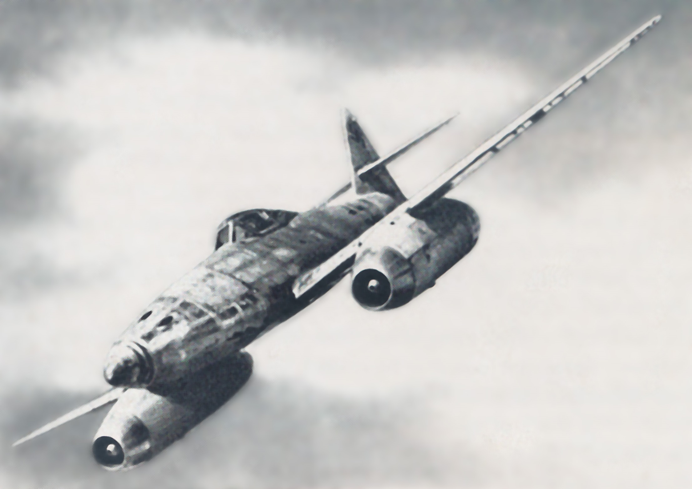
Technical and Historical
Study of the German Jets
Animated charts
F5 key, down arrow
Extensive footnotes;
View ~ Notes Page
AIAA Distinguished Lecture
Invited, Dayton Ohio: 17 Nov 2011
Update: 15 Jan 2016
J. Philip Barnes
Notes:
Just four days before the outbreak of WWII, the Germans flew the world’s first jet aircraft (1,2). By the last year of the war, the Allies were close behind with turbojet technology, but Germany was five years ahead in aerodynamic technology and configuration imagination. Today, 70-years later, both the real and conceptual “German Jets” continue to capture our imagination. Following a historical recap to put the presentation into perspective, we will review and renew some fundamental aerodynamic principles, introduce a semi-empirical 3D lifting-line aerodynamic model, and then apply all to study the top-level history and aerodynamics of several German jets, each noted for its unique configuration and/or contribution to the German war effort. For renditions of the jets, we are indebted to renowned computer-graphic artists* Mario Merino and Gery Gueville.
Throughout the presentation, I will attempt correct pronunciation of the various German names, and will likely encounter difficulty. I welcome corrections from the German-speaking members of today’s audience. But for those who do not speak German, I can assure you that Werner von Braun’s name is pronounced as the color brown. He will make a brief appearance in the presentation.
(1) A.C. Piccirillo, SAE 985598, Heinkel and the Turbojet Engine: Origin of the First Jet Fighter
(2) F. Crosby, A Handbook of Fighter Aircraft, Hermes House, 2004, p. 74, 106
* Of the many artists contacted for this project, only these two allowed their work to be
shared herein copyright free, provided the artist's name is retained on every image.

Slide 2
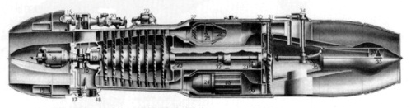
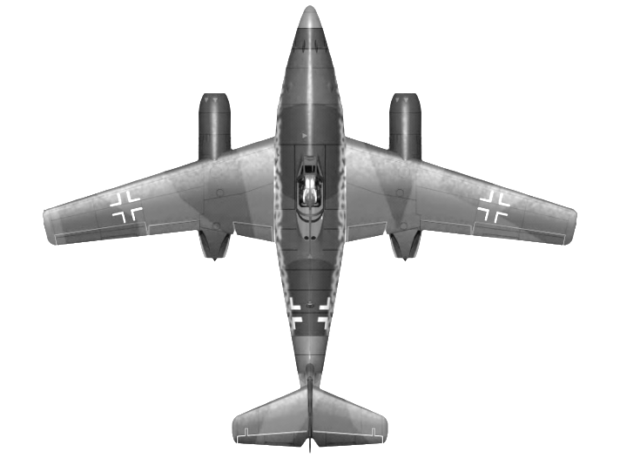
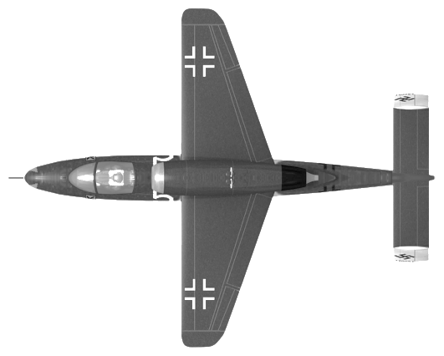
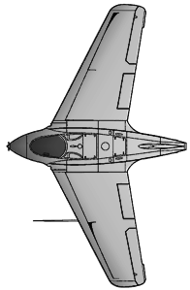
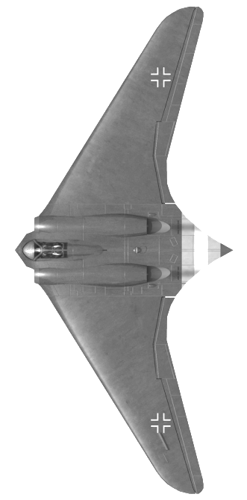
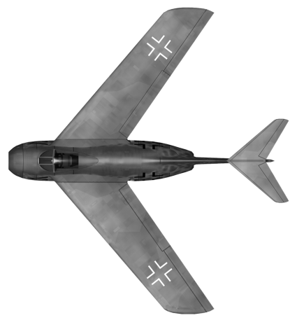
Presentation Contents
Historical background
Why a jet is faster than a prop
Aerodynamics
  - The swept-wing breakthrough
  - Forebody: low-aspect-ratio wing
  - 3D empirical lifting line model
  - Transonic treachery
  - Case study: Me 163B
Operational “turbos”
  Messerschmitt Me 262
  Heinkel He 162
Experimental jet: Horten Ho 229
Paper jets: Focke-Wulf, Junkers, Blohm&Voss
Summary, conclusions, and suggestions

Slide 3
Historical background, WWII European theater
WW1 Treaty of Versailles: Danzig/(Gdansk) port to Poland
1933: Hitler in power; 1938: territorial annexing “popular”
Luftwaffe: 4000 aircraft; Wehrmacht: 1.5-million-men
’39: German blitzkreig “shooting gallery” on Poland
‘40: Battle of Britain “draw” ; Invasion of Britain cancelled
’41: Blitzkreig “shooting gallery” upon Russians (initially)
’42-43 1st German losses: U-boats, Stalingrad, N. Africa
USA: produce bomber every 90-min, fighter each 50-min
Germans work 2 million slave laborers (aircraft & rockets)
Mar ’44: “silver” air supremacy; June ‘44: Allied invasion
“Shooting gallery” upon German army, cities, infrastruct.
German conscripts, 15-50, live avg. 29-days, east. front
Rumor: “wonder weapons” near (incl. real & paper jets)
Apr ’45: Hitler orders scorched earth, commits suicide
May ‘45: Germany surrenders; Cold war already begun

Slide 4
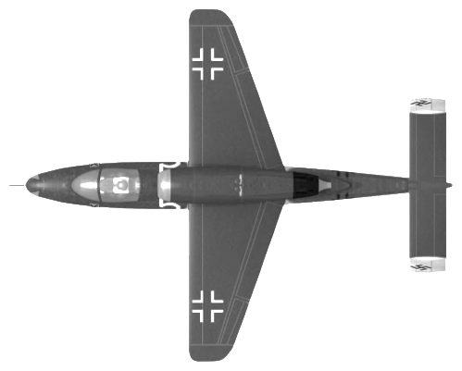
Operational jet chronologies and “personalities”
Me 163B
May ’44 - May’45: ~100 of 364 built are operational
Aug ‘44: Lose 14 jets; destroy (12) Allied aircraft
Transonic pitch-downs & wing-drops disrupt attack
4-min fuel for climb; vulnerable unpowered landing
Each Allied fatality: more than one Luftwaffe fatality
Me 262
July ’44 – May ‘45: ~300 of 1433 operational
18-22 Mar ‘45: (50) Allied aircraft destroyed
31 Mar ‘45: (21) Allied bombers destroyed
Apr-May ‘45: (50) victories, last 39 days of war
Pitch-down, flameout, & snaking disrupt attack
He 162
~50 of 238 begin operation for last week of war
“So much wood as...model aircraft enthusiast”
Lost 60 teens + others; downed (1) Allied fighter

Slide 5
Presentation Contents
Historical background
Why a jet is faster than a prop
Aerodynamics
  - The swept-wing breakthrough
  - Forebody: a low-aspect-ratio wing
  - 3D semi-empirical lifting line model
  - Transonic treachery
  - Case study: Me 163B
Operational “turbos”
  Messerschmitt Me 262
  Heinkel He 162
Experimental jet: Horten Ho 229
Paper jets: Focke-Wulf, Junkers, Blohm&Voss
Summary, conslusions, and suggestions

Slide 6
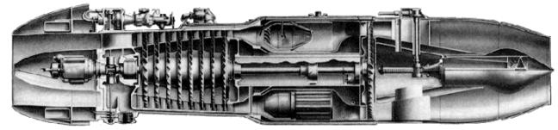
Why a jet is faster than a prop: Velocity Diagrams
Propeller
wake-induced velocities
Prop or Turbojet:
Inflow is axial
V_{x} ~ constant
W₂ ~ T.E. aligned
W₂ < W₁ (decel)
Static pressure rise
Impart sudden swirl
Increase absolute V
Turbojet/Turbofan
no induced velocities
W₂
ω r
W₂
Rotor entry
~Flight Mach
V₂
V₁
Rotor entry M ~ 0.45 for any flight Mach
Rotational wind
ω r + V_{iθ}
V₂
Relative
Inflow
W₁
V₁
V_{ix}
+
0
₋
Relative
Inflow
W₁
ω r
Rotational Wind
r/R
V_{iθ}
Prop wake-induced velocities
V_{o}+V_{ix}
Notes:
This chart addresses the key enabler of high speed for the German jets. That of course was the leap from the propeller to the axial turbojet. Above, we compare the velocity diagrams for a propeller and for the first stage rotor of a turbojet or turbofan. Blade camber, although normally used, is not needed to illustrate the concepts herein.
Key similarities of the two rotors include irrotational flow upstream, constant axial velocity through the rotor, pressure rise across the rotor, relative outflow approximately aligned with the blade trailing edge, and sudden swirl imparted to the flow.
But the key difference between the two is the axial entry Mach number. Whereas the propeller must deal with essentially flight Mach number, the turbojet or turbofan first stage (at full power) always sees approximately 0.45 axial Mach number, regardless of flight velocity. This allows only the turbojet to retain largely constant efficiency as airspeed enters the transonic regime and beyond.
Nevertheless, today's high-speed, propeller-driven aircraft such as the A400M can fly about as fast (Mach 0.72) as the German jets would have flown in cruise. We now know that "higher-speed" propeller flight is enabled by the use of "many" blades (say 8) at high pitch and low rotational speed.

Slide 7
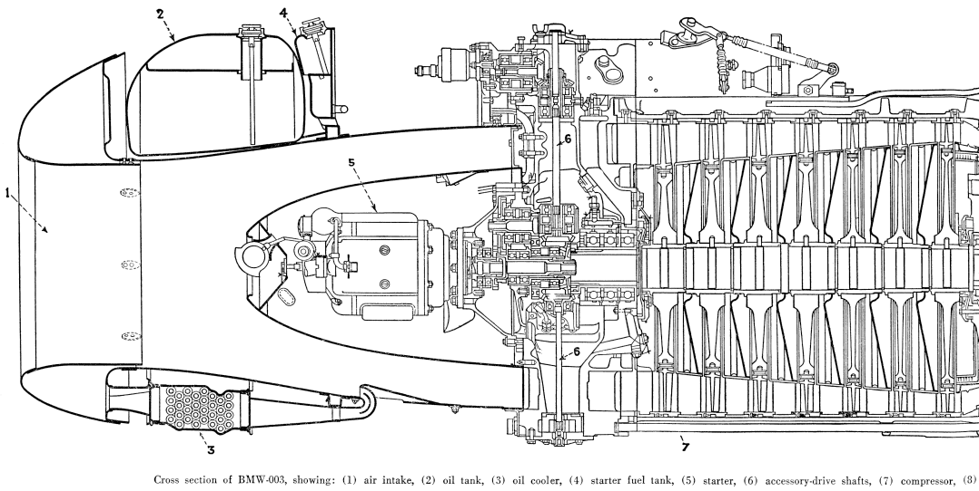
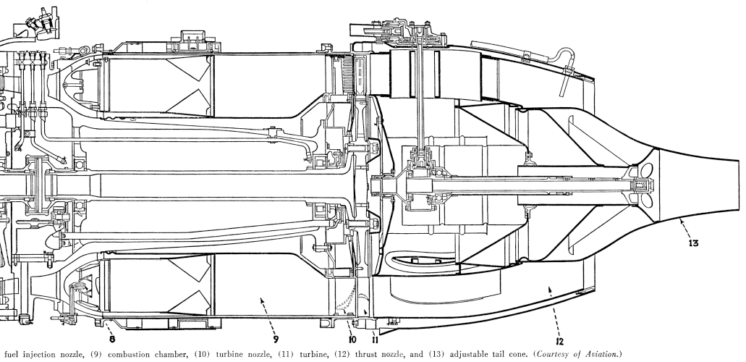
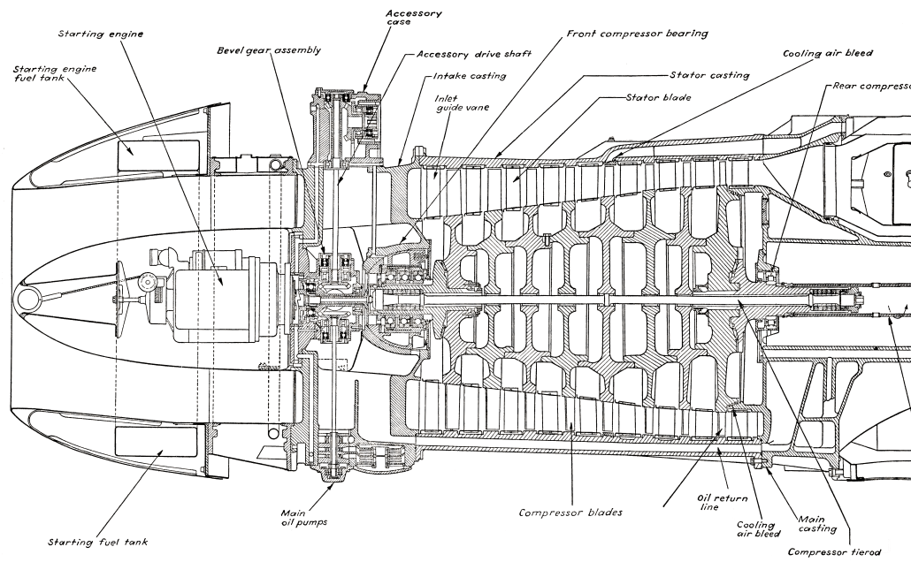
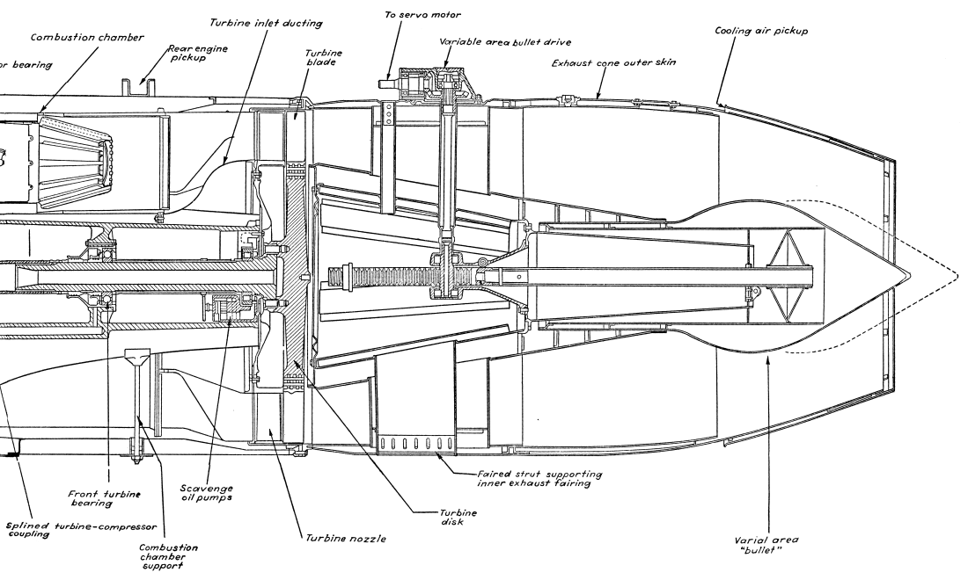
BMW 003 and JUMO 004 Turbojet Engines
9500
RPM
8700
1760 : 7.83
lb_{f} ~ F_{n} ~ kN
1980 : 8.81
1.21
F_{n} / W
1.11
3.1
P₃ / P₂
3.1
42 : 19
lb_{m}/s w_{a} kg/s
46 : 21
1.47
SFC ~ 1/hr
1.48
50
TBO ~ hr
10
Notes:
Courtesy of the 1948 text "Jet Propulsion Progress," (9) we show the cross sections of the BMW 003 and Jumo 004 turbojets. The BMW engine was somewhat smaller than the Jumo engine, but ran at higher RPM, exhibited higher thrust-to-weight ratio, and offered considerably greater time between overhaul. However, the Jumo engine was pressed into service before it was ready, and the BMW engine enjoyed more development time.
These engines had a similar specific fuel consumption (SFC). Throughout the atmosphere visited by a gas turbine engine, gravity is constant within the accuracy band of our performance calculations. Here, a "pound-mass" weighs the same as a "pound-force" and a "kg-mass" weighs the same as a "kg-force," so we can arguably define SFC as the ratio of fuel [weight] flow to thrust, and that for SFC yields common units and values for metric and Imperial systems. That being said, writing "pound" without a subscript may suffer an error factor of 32 when working with Imperial units. Best is to leave behind both Imperial units and metric "subscripted" units, instead using Newtons (or kiloNewtons) to characterize both thrust and weight.
We may note an apparent similarity of SFC and specific impulse (I_{sp}), but neither is the inverse of the other. First, (I_{sp}) is defined as impulse per unit "propellant" weight, with such weight based on sea level gravity. Thus, (I_{sp}) is also the ratio of thrust to propellant weight flow. Second, a jet aircraft's "propellant" is not just the fuel; it is the hot gas, consisting of air with perhaps 2% fuel/air ratio. Thus, whereas the German jet engines exhibited (I_{sp}) near 40-sec, a rocket may have (I_{sp}) at 400-sec. But the rocket's advantage is only apparent, as it must carry its own oxidizer "air."
(9) L. Neville and N. Silsbee, Jet Propulsion Progress, McGraw-Hill, 1948

Slide 8
Presentation Contents
Historical background
Why a jet is faster than a prop
Aerodynamics
  - The swept-wing breakthrough
  - Forebody: a low-aspect-ratio wing
  - 3D semi-empirical lifting line model
  - Transonic treachery
  - Case study: Me 163B
Operational “turbos”
  Messerschmitt Me 262
  Heinkel He 162
Experimental jet: Horten Ho 229
Paper jets: Focke-Wulf, Junkers, Blohm&Voss
Summary, conslusions, and suggestions

Slide 9
Historic Test Data ~ 1 of 2
45º sweep reduces the zero-lift drag
by 50% with the same area, aspect ratio, & streamwise airfoil thickness
Notes:
This is the historic test data, taken by Hubert Ludwieg in association with Albert Betz, using the AVA wind tunnel. The data shows the superior drag polar of a swept wing, versus a straight wing, at 0.8 Mach number. The Gö 623 airfoil was unsuitable for transonic flight, having 12% thickness and 2% camber, giving the appearance of perhaps a 14% thick airfoil to the transonic flow. But although this may have affected the drag polar comparison, it did not invalidate the trends. Also, this historic data was taken with very small models (8=cm span) and thus was affected by low Reynolds number. But the trends were later validated by a similar test of much larger scale (next slide). Note that the two tested wings shared the same span, area, taper ratio, and streamwise airfoil, but the swept wing exhibited much lower zero-lift drag.
Today's commercial transport aircraft use inverted forward camber near the wing root to enable the localized use of a thick airfoil.

Slide 10
Historic wind-tunnel test data – the swept wing
Sweep benefit, M 0.80
same aspect ratio
same streamwise foil
Saab copy of report
Shared with Allies
“not interested”
35º sweep reduces zero-lift drag 45% at fixed area, aspect ratio, and streamwise airfoil thickness
Notes:
This test data, taken with much larger models, confirmed the superiority of sweep for the high-speed drag polar, holding fixed streamwise airfoil section and fixed aspect ratio. Again, the zero-lift drag is dramatically reduced by sweep alone. Thus, the popular explanation of reduced drag due to reduced streamwise thickness doesn't apply. How then do we explain this phenomenon?

Slide 11
Effect of sweep on zero-lift drag ~ infinite swept wing
Focus on "normal" flow properties (Munk, Busemann)
  Velocity (w) & Mach (M cosσ)
  Chord (n) & thickness ratio (t/n)
  Flat-plate incidence (if lifting)
  Drag coef. (c_{dn}) @ (t/n) & Mcosσ
  Translate to streamwise basis
v
w
M
σ
M cos σ
n
c
dN
ds
dD
dy
Sweep reduces zero-lift drag even at Mach 0.00
For c_{d} based instead on normal chord (n), exponent=2
Drag reduction with sweep also significant at low speed
Benefit diminished near root or tip, or at low aspect ratio
Notes:
Max Munk was first to point out that swept wing aerodynamics are dominated by the normal flow component (NACA TN 177, year 1924). Adolf Busemann, in his 1935 classic paper at the Volta Conference, then incorporated this fact to model the advantages of sweep at supersonic Mach number. When Albert Betz independently suggested the subsonic application of sweep, Busemann had already approached Willy Messerschmitt with the same idea (6).
Since a wing at high speed operates at low lift coefficient, we can estimate the benefits of sweep by studying a "swept-infinite" wing at zero lift. The figure above, representing an original analysis of the well-known swept-infinite wing, first accounts for various terms affecting the "normal" drag coefficient (c_{dn}) corresponding to the normal velocity (w) and normal chord (n) and then translates to a streamwise basis for the drag coefficient (c_{d}) referenced to flight velocity (v) and chord (c). The result has two terms, the first showing a strong benefit of sweep, and the second representing a penalty for "sparwise" friction with effective friction coefficient (c_{fs}). Zero-lift drag is thus in principle reduced by sweep also at low speed, a trend seen for the swept-infinite wing data of ARC R&M 2458, as well as for finite swept-wing test data of NACA TN 1709, NACA RM L6J01A, and NASA TP 2068 (sweep via "yaw," reduced aspect ratio). We then postulate that a swept wing with twist for elliptical loading exhibits a higher max L/D than an unswept wing, also optimally twisted, having the same aspect ratio and streamwise section. Such benefit is at least seen at high speed, where the German Jets applied both sweep and twist.

Slide 12
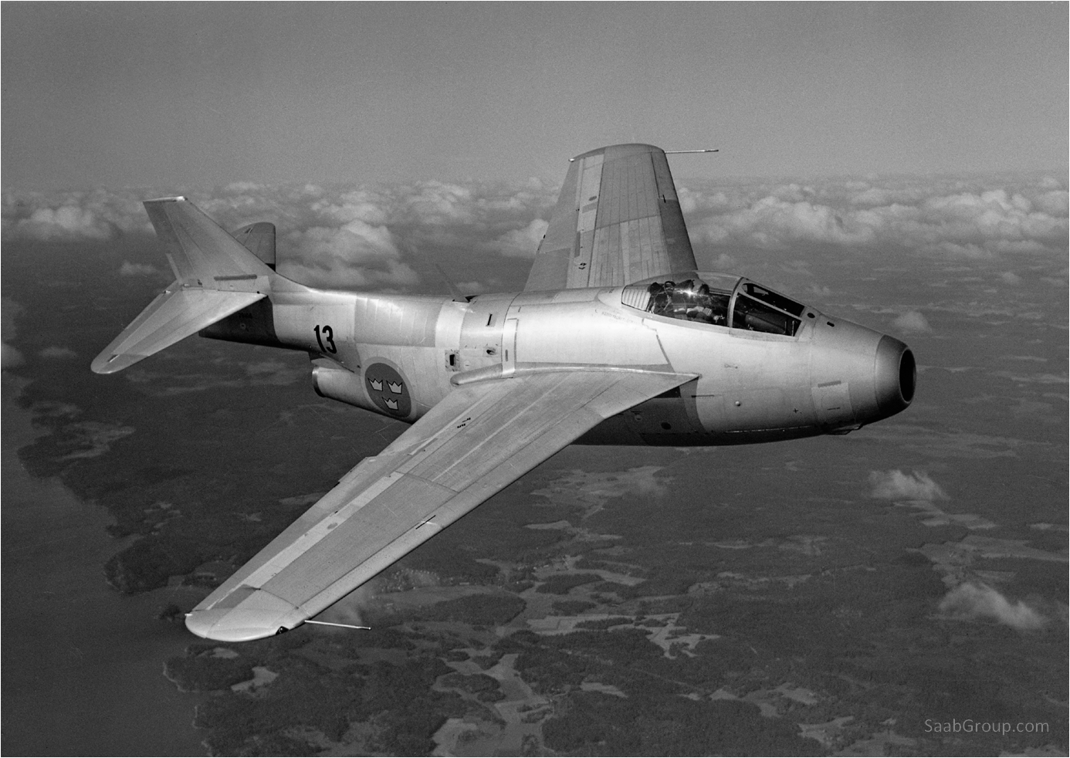
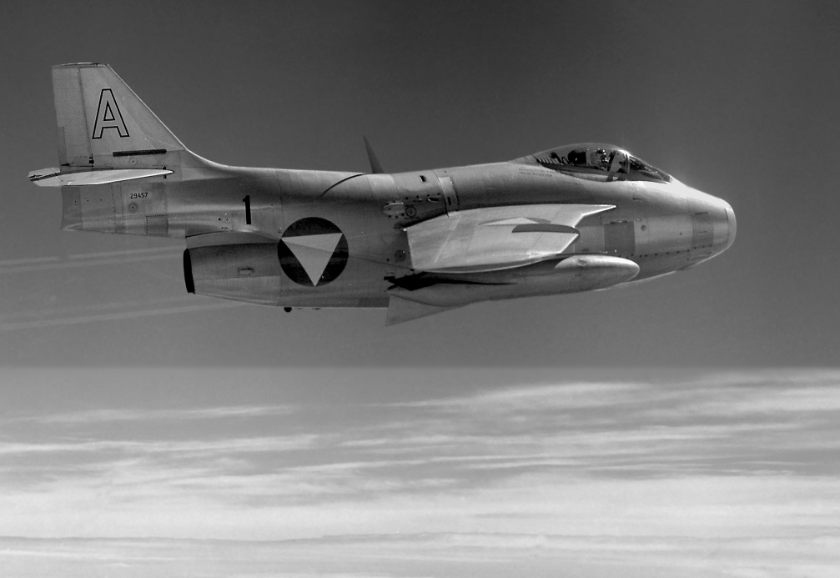
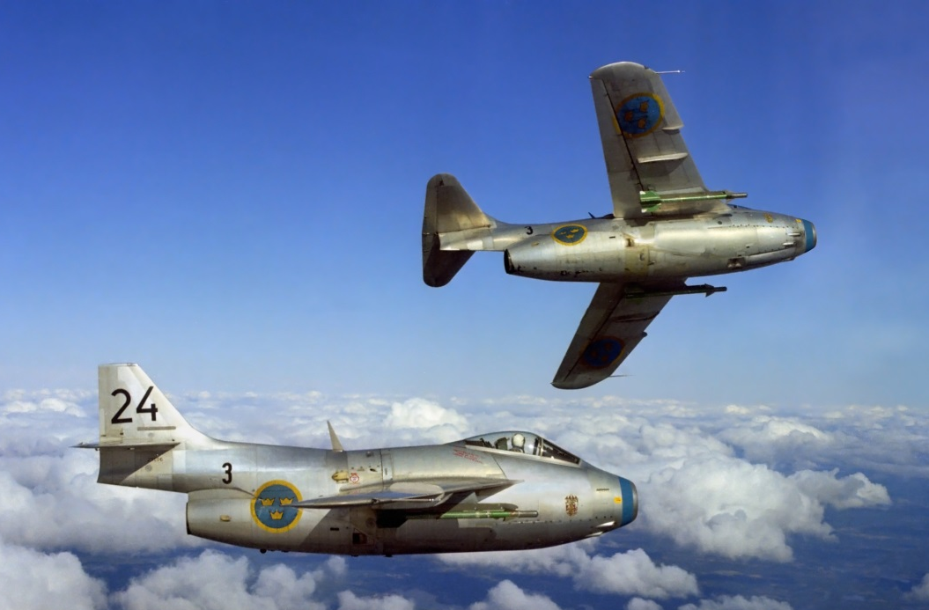
Saab J29 Tunnan (“Flying Barrel”)
First flight 1948 *
First sweep for aero
Leading edge extension
Early "area ruling" **
Mach 0.86 level flight
SaabGroup.com
SaabGroup.com
SaabGroup.com
* Saab-Scania Story, 1987 ** Lars Helmersson e-mail
Notes:
The Saab J29 Tunnan “flying barrel” was the first operational jet to use wing sweep strictly for its aerodynamic advantage (Me-262 wing sweep was implemented solely to manage c.g. position). The Tunnan was also ahead of its time in adopting a sharp leading-edge wing root extension, and in perhaps the world's first application of "area ruling," the fuselage maximum thickness was by design kept well forward of the wing to mitigate shockwave effects at the wing-body junction.* This no doubt led to the J29 "barrel" nickname, and arguably served to discredit the popular phrase "It has to look good to fly good."
As with other swept-wing jets of the late 1940’s or early 1950’s, “swept-wing euphoria” begat clean wings at the outset (upper right photo), with reality then setting in via flight test as the side effects of sweep became apparent. Subsequent versions would add fences, and/or sawtooth snags to mitigate the swept wing’s tendency, at higher angles of attack, to stall at the tips and thus generate unwanted pitch up. The J29 did not incorporate wing twist.*
* Sept 2013 e-mail from Lars Helmersson, Principal Engineer (Ret.) Saab Aeronautics

Slide 13
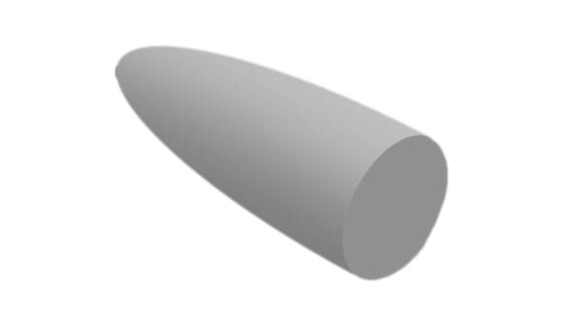
Forebody Linear Aerodynamics
Forebody is low-aspect-ratio wing, both top & side views;
Force via b² not aspect ratio,
Insensitive to flight Mach No.
b
A forebody & low-aspect wing of the same “span” (b) yield the same lift (L)
Aft fuselage immersed in downwash/sidewash & “low-quality” flow
  ~ Neglect aft fuselage contributions to pitch and yaw moments
Plan view: “span” is max width; For sideslip, “span” is max depth
Aspect ratio, A = b²/S ; R.T. Jones, Low-A: c_{L} = L / (qS) = (π/2)Aα
Given the definition of aspect ratio, this becomes: L/(qb²)= (π/2)α
M.Munk: dL/dx (Lift per axial distance) is proportional to d(b²)/dx
R.T. Jones: “Loading is elliptical, and independent of planform”
  - same result for cones, paraboloids, or ellipsoids
R.T. Jones: “These results are independent of Mach number”
Notes:
With the advent of the jet engine came the lengthening of the forebody and sweeping aft of the wings. Both effects increase the de-stabilizing effects of the forebody in pitch and yaw. The forebody is in effect a low-aspect-ratio wing, developing the same lift as a wing of the same “span” (b). This was independently realized by the present author, and 50 years earlier, by Hans Multhopp (12). For the forebody profile, the “span” becomes the maximum depth. For either the forebody plan or forebody profile, the “span” is taken at the point of maximum width or depth. And per Robert T. Jones (13), the lift coefficient (or side-force coefficient) of the forebody is unaffected by Mach number, and its lift is distributed elliptically across the “span.” Max Munk (14) showed that the pitching moment of an airship is less than the theoretical “slender-body” value, depending on forebody length-to-diameter ratio. Sighard Hoerner (15) provides an empirical correction for this effect in terms of the forebody length-to-span ratio.
(12) H. Multhopp, Aerodynamics of the Fuselage, NACA TM 1036, 1942, p. 7-9
(13) R.T. Jones, Properties of Low-aspect-ratio Pointed Wings ..., NACA 835, 1945
(14) M. Munk, Airship Theory, NACA TR 184 (1923), NACA TR 191 (1924)
(15) S. Hoerner, Fluid Dynamic Lift, Hoerner Fluid Dynamics, 1985, p. 17-2, 19-2

Slide 14
3D empirical lifting-line Method (subsonic, linear, longitudinal & lateral)
Solve interactive horseshoe vortices
Wing, emp’nage, forebody cruciform
Equivalent-flat-plate airfoil incidence
Transonic M: shift downwash line aft
PURPOSE
Virtual wind tunnel, 3D config.
Forebody & multiple surfaces
Linear aero forces & moments
Angle of attack and/or sideslip
Low speed to “Low transonic”
METHOD
Horseshoe vortices throughout
Solve linear simultaneous EQs
Equivalent flat-plate airfoil
Chord vector incidence
Lifting-line & downwash line
Prandtl-Glauert correlation
Empirical ± tip-lift bump in yaw
Trailing
vortices
Downwash line
Lifting line
Cambered airfoil
chord line and
zero-lift line
ζ
α
Aero equivalent
Thin, flat airfoil
α+ζ
Notes:
Our “Wing-body Linear Longitudinal-Lateral Lifting Line” method computes the distribution of lift (actually normal force), profile drag, and induced drag over all significant aerodynamic surfaces including the forebody planform, forebody profile, wing, and empennage. The analysis, limited to subsonic, linear aerodynamics below critical Mach number, aligns “horseshoe vortices” along lifting lines near ¼-chord, conforming with various empirical modifications to each aerodynamic surface. A corresponding downwash line, nominally at ¾-chord, contains the locus of points at which the equivalent flat-plate airfoil flow-tangency boundary condition is applied, together with the local equivalent flat-plate incidence which is determined from two vector operations, the first a cross product of the chord vector and flight-velocity vector to yield the magnitude of incidence, and the second a cross product with the local “unit dihedral” vector to determine the sign of the incidence. Rather than adjust aircraft and vortex geometry for angle of attack and sideslip, instead the flight velocity vector is tilted by these angles, with only selected adjustments of wing coordinates applied to account for differential sweep and downwash-node position in sideslip. Simultaneous equations, typically less than 100 per aircraft, are solved to yield the distribution of bound-vortex strength, from which local normal forces can be computed. The “apparent downwash” method then determines the local induced drag by comparing the observed local lift to that expected based on local incidence and local sweep, together with Mach number. Surfaces such as a blended wing-body are modeled “tip-to-tip.” For sideslip, empirical differential “bumps” in wingtip-local lift are added to represent the yaw and roll-moment correlations shown earlier herein, but such effects are overshadowed in the presence of any "non-planar" features such as dihedral, winglets, or forebody, all strongly influencing the lateral moments.

Slide 15

3D lifting-line validation: Wing & Forebody Lift Distributions
Forebody wing impact
similar to that of canard
Total lift ~ elliptical
Data: NASA TN D-712
Wing & body Press. Taps
Incl. submerged wing
Planar wing, axi-body
4% airfoil thickness
Mach 0.9, α=4.5º
Wing+body lift: elliptical
Notes:
A thorough validation of the 3D lifting-line method would involve a wide range of configurations and conditions far exceeding the scope of this article. Also, at this time the method is still in development. Nevertheless, in this section we validate the method for selected cases applicable to the German jets to be studied subsequently.
First and foremost is the distribution lift for a wing and body combination. NASA TN D-712 represents a rare, but immensely useful, characterization of wing-body aerodynamic loads by adding pressure taps to the portion of the body coinciding with the “submerged” portion of the wing. As seen in the figure above, the wing lift distribution exhibits a pronounced “dip” which is essentially replaced by forebody lift, whereby the total wing-body lift is nearly elliptical. Here, the forebody wake induces downwash on the wing to an extent somewhat greater than that calculated by the method. Nevertheless, the computed loads (forebody and wing) reasonably match the measurements, even though 0.9 flight Mach number is outside the applicability of the Prandtl-Glauert correction for compressibility used by the method.

Slide 16
3D lifting-line validation ~ Swept & Twisted Wing with Body
NACA RM A50J24
c_{L}= 0.22
α = 6º
10º washout
6º AoA ; 10º washout
Strong upwash at tips
Notes:
We now progress beyond a planar wing to a cambered wing with 10º twist, again tested with a body, but with only “exposed wing” loads measured. Again, the calculation agrees well with the test data. A key point of interest is the outboard upwash, whereby even with the wing root at 3º angle of attack and the wingtips at -7º angle of attack, the lift distribution remains largely positive and throughout, exhibiting nearly a “half-sinusoidal” shape.

Slide 17
Transonic Treachery ~ Shock Stall of a Swept & Twisted Wing
Sweep & “thick” root foil, transonic Mach: Wing-root lift loss and strong pitchdown
Flight Mach > airfoil “critical” Mach
Shock-induced b’layer separation
  ~ Root upper / tip lower (1,2)
Sudden re-attachment of flow
High-frequency pitch up/down
Pilot and structure over-g
Me 163, DH 108, & others
B
B
A
C
NACA 0009
(dc_{L}/dαº)_{M}
C
(dc_{L}/dαº)_{M=0}
NACA ACR L5E21
Mach (M)
German Development of the Swept Wing
Meier/Krag, p. 465
Meier/Meier, p. 203
Notes:
This chart summarizes the overall effect of the series of schlieren photos for a similar 9% thick airfoil. Here we have plotted the lift slope versus flight Mach number. We shall study the aerodynamics of the German jets near region (A), where transonic effects increase the lift, but where shocks are not present.
In region (B) a shock has appeared on the upper surface, moving aft and increasing in strength as flight Mach number increases, and causing a reduction of lift due to the increased upper-surface pressure downstream of the shock.
In region (C) a shock has appeared on the lower surface, tending somewhat to restore lift. But both shocks are subject to "wandering," potentially at high frequency, with cyclic effects on lift, drag, and pitching moment.

Slide 18
Presentation Contents
Historical background
Why a jet is faster than a prop
Aerodynamics
  - The swept-wing breakthrough
  - Forebody: a low-aspect-ratio wing
  - 3D semi-empirical lifting line model
  - Transonic treachery
  - Case study: Me 163B
Operational “turbos”
  Messerschmitt Me 262
  Heinkel He 162
Experimental jet: Horten Ho 229
Paper jets: Focke-Wulf, Junkers, Blohm&Voss
Summary, conslusions, and suggestions

Slide 19
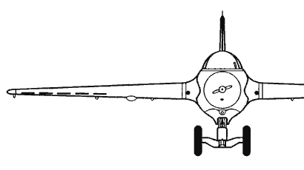
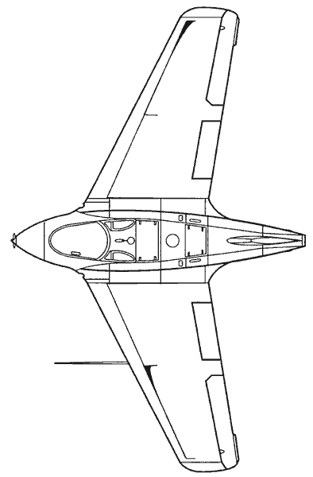
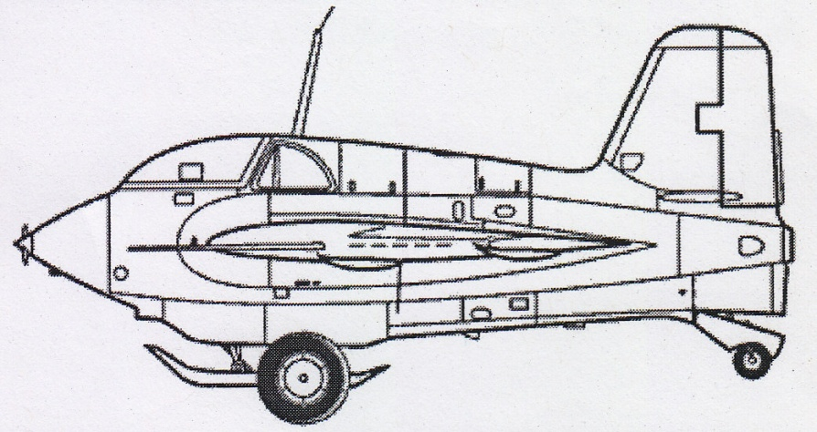
Messerschmitt 163B ~ Numerous aero principles illustrated
Sweep for pitch trim
Thickness 14% / 09%
Critical Mach: 0.75
Root airfoil reflex
5.7º chord-line twist
c.g. 21% M.A.C.
Elevon
3-View by Lloyd S. Jones
Flap
Forebody & fin “competition” in yaw
Adverse effects on the fin:
- Wing wake (reduced fin area)
- Forebody wake in sideslip
- Transonic lift loss above crit. Mach
Forebody Vs. fin
Flaps: sweep+twist = pitch-up
Thus elevons go down to trim
All aft edges down for landing
Notes:
The rocket-powered Me 163 provides an excellent platform to illustrate the application of the aerodynamic principles discussed thus far. The wing uses a combination of sweep, twist, and reflexed airfoil to attain longitudinal trim. The forebody represents two low-aspect wings, one in the planform and the other in profile. And just as the wing is immersed in downwash due to forebody lift, the fin is immersed in sidewash due to forebody side forces in sideslip. For both surfaces, downwash or sidewash degrades aerodynamic effectiveness. Although the fin has higher aspect ratio than the forebody and enjoys a certain “end-plate” benefit in its attachment to the afterbody, only the forebody enjoys "clean" flow and insensitivity to the effects of increasing Mach number.
Notwithstanding its caustic propellant and hard-landing skid, the Me 163 exhibited excellent flying qualities, as noted by Capt. Eric Brown (16) upon flying the aircraft as a glider just after the war. But early in its development, the Me 163 was test flown beyond its critical speed by pilot Heini Dittmar, to Mach 0.84 where it exhibited instability about all three axes (6). As we noted earlier, the forebody develops lift and side force coefficients unaffected by Mach number. But as we'll learn later herein, a wing or fin with a relatively “thick” airfoil suffers effects of "transonic treachery" beyond a critical Mach number.
(16) Capt. E. Brown, Wings of the Luftwaffe, Airlife, 1993

Slide 20
Presentation Contents
Historical background
Why a jet is faster than a prop
Aerodynamics
  - The swept-wing breakthrough
  - Forebody: a low-aspect-ratio wing
  - 3D semi-empirical lifting line model
  - Transonic treachery
  - Case study: Me 163B
Operational “turbos”
  Messerschmitt Me 262
  Heinkel He 162
Experimental jet: Horten Ho 229
Paper jets: Focke-Wulf, Junkers, Blohm&Voss
Summary, conslusions, and suggestions

Slide 21
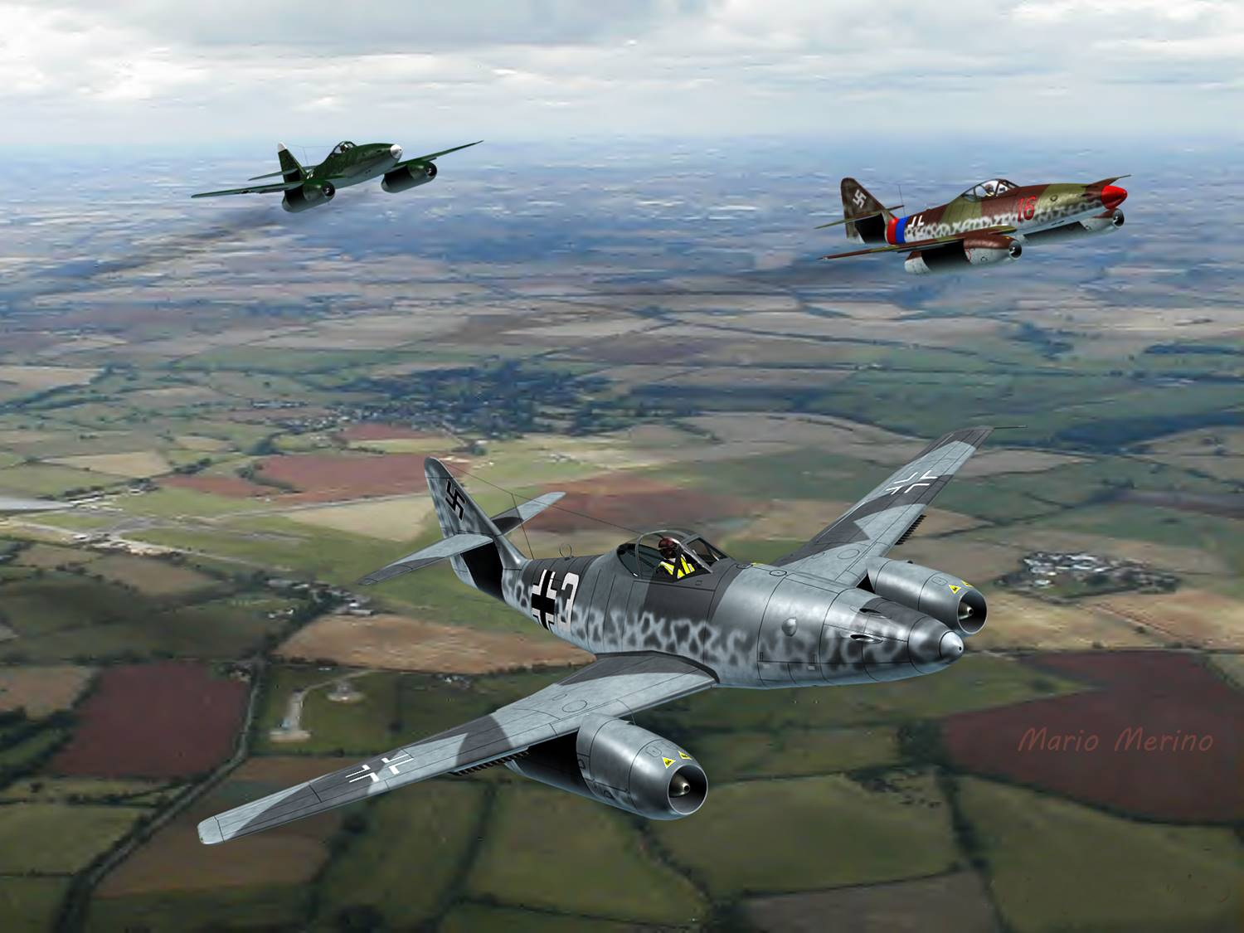
Luftwaffe , ‘39 ~ "No new designs"
Voldemar Voigt ~ "fired & hired"
A. Galland, ‘43 ~ “Start production now”
Hitler: “Nothing...until I have decided...”
  19 of every 20 shall be bombers
Capt. Brown: Max “tactical” Mach 0.82
“2x100” attack & escape
Notes:
Me-262 formation, image courtesy of Mario Merino
Early in the development of the Me-262, the German leadership felt the war would soon be won with the aircraft already on hand, and the designs of new aircraft were halted for a time. However, work on the Me-262 continued under the leadership of Dr. Willy Messerschmitt and his chief designer, Dr. Voldemar Voigt. On perhaps a half-dozen occasions, Voigt and Messerschmitt would have a major disagreement, with Voigt fired on the spot and then invited to return the next day (3).
General Adolf Galland, who would survive the war with 104 victories, including four in the Me 262 (4), stated that it felt like "angels were pushing" when he first flew the Me-262. The aircraft was capable of sustained level flight up to 0.8 Mach number, but this was also the safe limit for a dive. Based on Galland's observation of trends in the final months of the war, he stated that if 300 Me 262 jets had been operational, the Luftwaffe could have downed 200 Allied bombers per day, forcing a stop to daytime bombing (4). But by the time such Allied bombers with fighter escort blackened the German skies, the actual number of operational Me-262 jets was far too few. W. J. Boyne (5) aptly described the Me-262 as a "fascinating sidebar to the war" and "a final challenge from Germany's proud aeronautical engineers."
(3) D. Myhra, Secret Aircraft Designs of the Third Reich, Schiffer, 1998, p. 10
(4) H. Morgan and J. Weal, German Jet Aces of WWII, Osprey, 1998, p. 62
(5) W.J. Boyne, Messerschmitt Me262 Arrow to the Future, Smithsonian, 1980

Slide 22
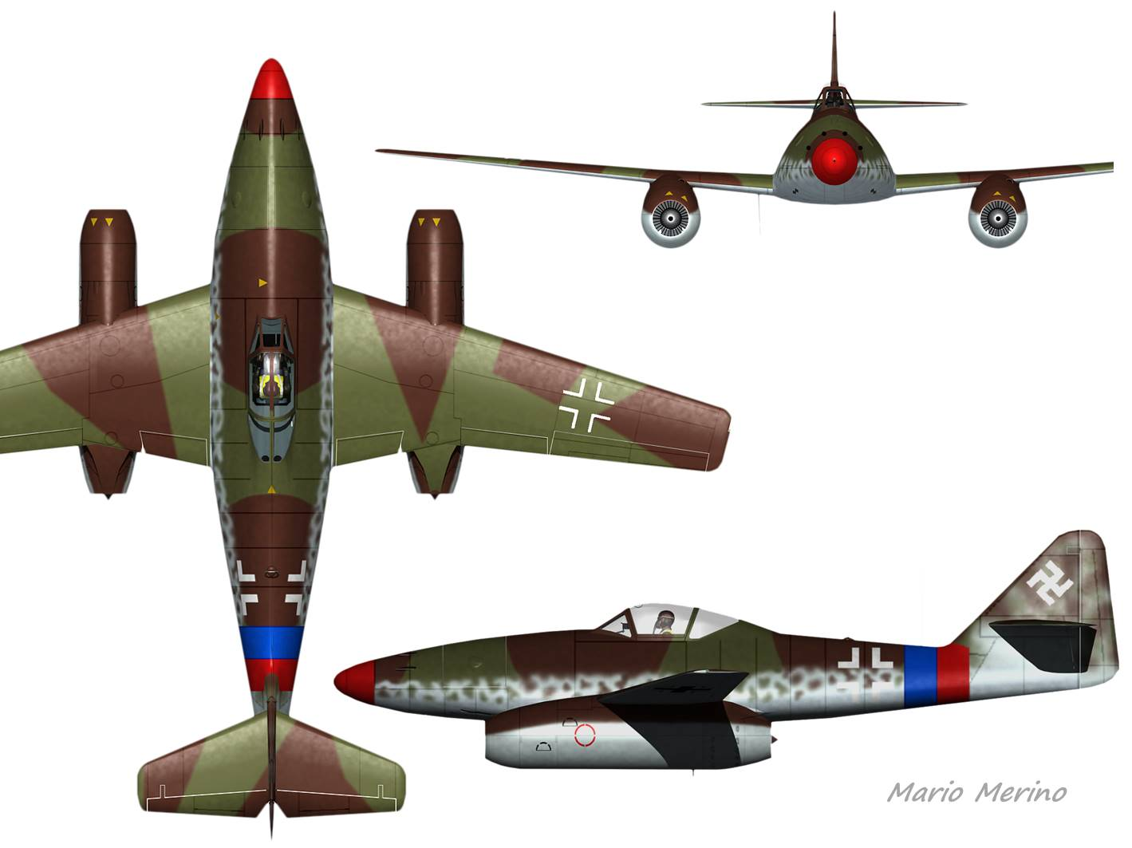
Messerschmitt Me-262
Sweep for c.g.
Jumo 004
1-engine flameout
High-speed snaking
Notes:
The Me 262 wing was swept only to manage the aircraft center of gravity. With its long nose and engine cowls forward of the c.g., the aircraft suffered marginal yaw stability and tended to snake at high speeds (6).
With its widely-spaced Jumo 004 engines, either of which could easily flame out in response to aggressive throttle movement, the minimum airspeed to safely sustain a one-sided flameout in the Me-262 was relatively high. This accounted for the loss of several pilots and aircraft.
The Luftwaffe pilots respected the limits of the aircraft, to the extent possible in aerial combat, while exploiting its strengths. The world's first aerial victory of a jet fighter took place on 26 July 1944 with Leutnant Alfred Schreiber downing a Mosquito reconnaissance aircraft (7).
(6) H. Meier, German Development of the Swept Wing, AiAA, 2006, p. 448
(7) H. Diedrich, German Jet Aircraft 1939-1945, Schiffer, 2000, p. 26

Slide 23
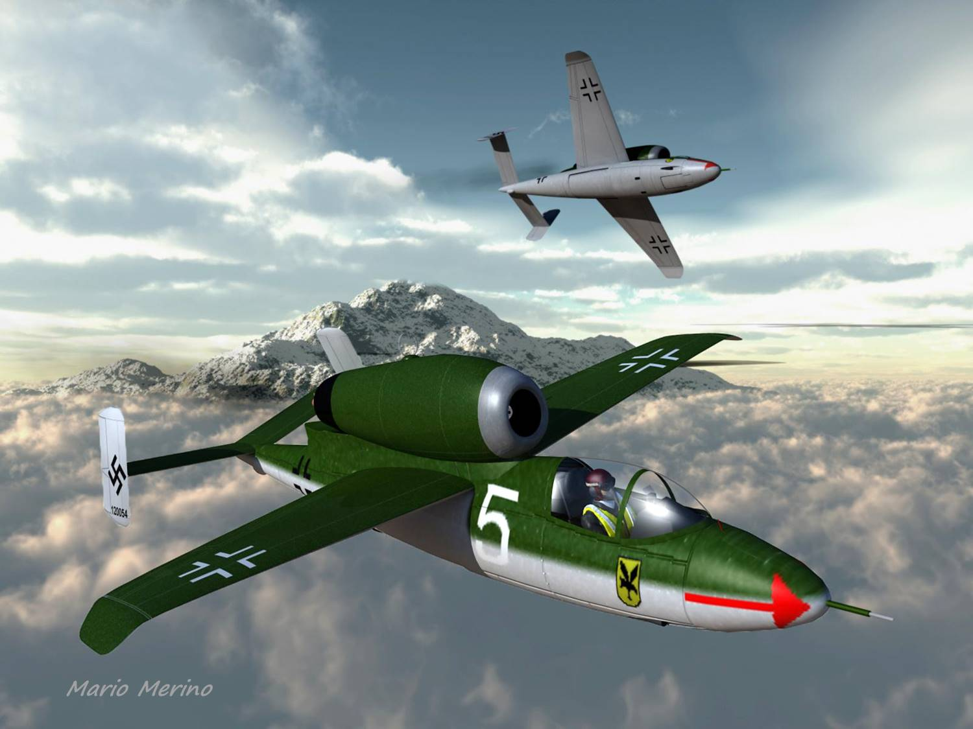
Heinkel He 162
Volksjäger "winner"
Karl Franke of Heinkel
38 day dwg to prototype
60/65 teen pilots lost
“Best fighter of its time”
“Phenomenal roll rate”
Ernst Heinkel legacy
Notes:
The He-162 was the winner of the Volksjäger (People's Fighter) competition, but the competition was anything but that. With entries from Heinkel, Blohm&Voss, Arado, Junkers, and others, the Luftwaffe leadership invited Heinkel's chief of technical operations, Karl Franke, to judge the various designs and bring forth a predictable recommendation (8). The winning concept was designed and flown within 90 days, with the first prototype built within 38 days of drawing release.** But such haste was likely a factor in the ultimate loss of five test pilots. The aircraft incorporated the first ejection seat, but this was not automatically integrated with canopy jettison. One pilot was killed trying to eject before the canopy was released.
Assembled largely of wood with slave labor, the aircraft deservedly suffered the occasional nearly-severed cable and/or thinly-applied glue. Together with various accidents, this claimed the lives of 60 of 65 teenaged Luftwaffe checkout and delivery pilots. A young Harald P. Bauer was one survivor.*
Arguably, the failure of the He-162 to aid the German war effort deprived Ernst Heinkel of the full credit he deserved for his earlier and historical achievement of bringing forth the world's first jet-powered aircraft. But shortly after the war the reknowned test pilot, Capt. Eric Brown of the Royal Navy, flew all of the German jets and pronounced the Heinkel 162 to be the “best fighter of its time” as a fast and steady gun platform with a “phenomenal roll rate.”
* Harald P. Bauer, Presentation, Western Museum of Flight, June 2012
** Picarillo, SAE ....

Slide 24
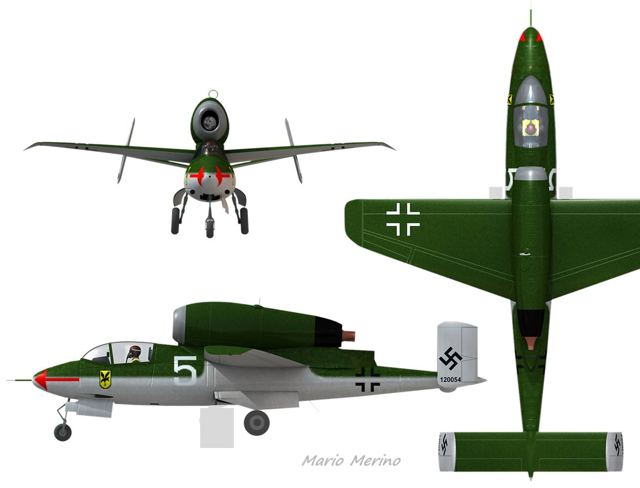
Heinkel He-162
Final week of war
Hitler Youth plan
No fuel or strategics
Notes:
The Heinkel He-162 entered a “hybrid” training/operational status in the last week of the war. In theory, it was to be flown in large numbers by the Hitler Youth, since the Luftwaffe by now had few remaining pilots, and since all able-bodied males between the ages of 15 and 50 were subject to conscription. But the planned production of the He-162 fell far short since the Allied bombers had laid waste to Germany's railway system upon which German aircraft manufacturing depended for delivery of subassemblies.
As the situation for the Germans deteriorated, work on the He-162 was halted to focus on a select handful of other aircraft. But here, to put our own concerns about job security into perspective, note that the Heinkel engineers were then subject to conscription and assignment to the Russian front. Fortunately for them, the program was quickly turned back on (8).
(8) P. Müller, Heinkel He 162 "Volksjäger," Müller History Facts, 2006, p. 49

Slide 25
Presentation Contents
Historical background
Why a jet is faster than a prop
Aerodynamics
  - The swept-wing breakthrough
  - Forebody: a low-aspect-ratio wing
  - 3D semi-empirical lifting line model
  - Transonic treachery
  - Case study: Me 163B
Operational “turbos”
  Messerschmitt Me 262
  Heinkel He 162
Experimental jet: Horten Ho 229
Paper jets: Focke-Wulf, Junkers, Blohm&Voss
Summary, conslusions, and suggestions

Slide 26
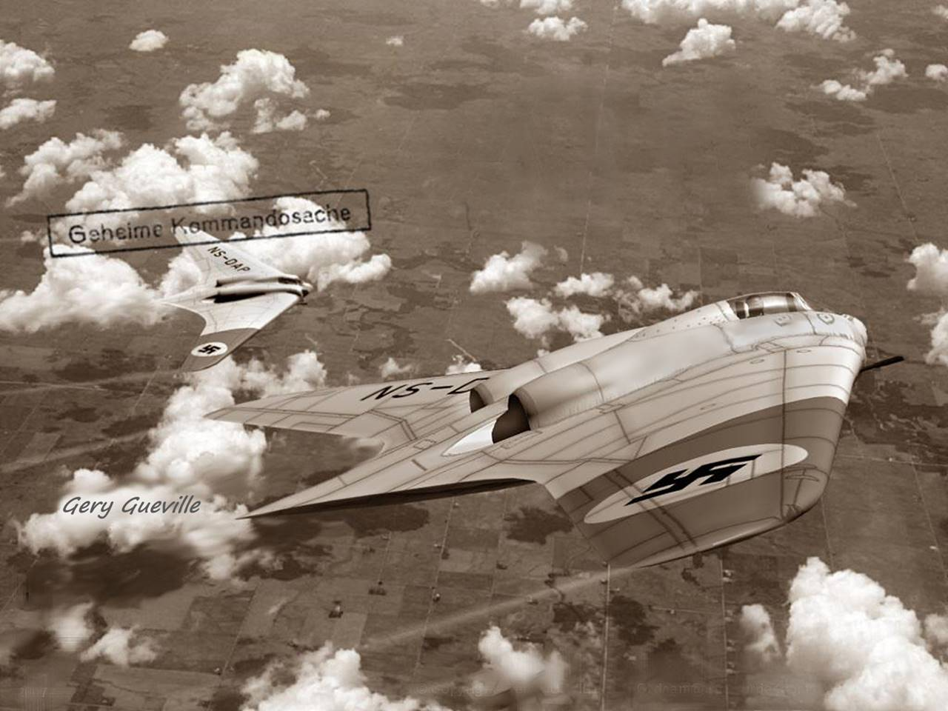
Horten Ho-229 (V.3)
Göring support
V.3 ~ Gotha
Notes:
With this creative image by computer-graphic artist Gery Gueville, we introduce perhaps the most radical of the German Jet designs, the Horten Ho-229. Offered as a contender for the last-ditch Volksjäger (People’s Fighter) competition, the Ho-229 was a favorite of Air Marshal Hermann Göring. After providing funding for the Horten team to build and fly V.2 (19), he directed Gothaer Wagonfabrik (Gotha) to carry out detailed design and construction of V.3. The Gotha team introduced numerous improvements, in particular the forward shift of the Jumo 004 engines to eliminate all 200 kg of nose ballast.
(19) D. Myhra, The Horten Ho 9/Ho 229: Technical History, Schiffer, 2002, p. 9, 28

Slide 27
Isolated Planar Wing ~ Yaw-moment Correlation
Isolated wing yaw stability much reduced as lift coefficient falls off at high speed
Wind-tunnel data, Planar wings
S.Hoerner: Fluid Dynamic Lift
NACA: TN703, TN1468, TN1581,
TN1671, TN 2445, RM A6K15
Positive “c_{n}β” is stable
Sweep ~ powerful benefit
Unswept ~ marginal, stable
Taper/ellipse ~ no penalty
(dc_{n} /dβº)/c_{L}²
With twist: Yaw-neutral at the incidence corresponding to wingtips locally “unloaded”
β
Yaw neutral as c_{L}→0
n
Notes:
The chart above, based on test data from several NACA reports, correlates the yaw moment coefficient (c_{N}) with lift, sweep, and aspect ratio for isolated, planar wings (untwisted with no dihedral). Interestingly, even a planar rectangular wing is “somewhat” stable in yaw, but for any wing without dihedral, yaw stability requires lift overall for a planar wing (or, we postulate, near the wingtips of a twisted wing).
The dependence of planar-wing yaw stability on lift was shown by Albert Betz, among the first to investigate the yaw stability of isolated wings. He showed that yaw stability vanishes at zero lift because the differential forces which provide yaw stabilization originate from differences in induced drag. Thus, if a planar wing develops no lift (or if the tip regions of a twisted wing develop no lift), then the wing will be “neutral” in yaw. Indeed, the restoring yawing moment is proportional to the square of wing (or tip-local) lift coefficient.
As seen in the chart above, sweep combined with low aspect ratio provides a significant increase in the yaw stability of an isolated wing. Based on limited data, it appears that forward sweep yields near-neutral or slightly-negative yaw stability, whereby dihedral is essential unless active yaw stability is to be provided.

Slide 28
Isolated Planar Wing ~ Roll-due-to-yaw Correlation
Roll “neutral” @ c_{L}=0
“c_{l} β^{ο}” ≡ dc_{l} / dβ^{ο}
Negative “c_{l} β” is essential
Sweep ~ powerful benefit
Unswept ~ marginal / poor
With twist: poor handling at the incidence corresponding to wingtips locally “unloaded”
c_{l} βº/c_{L}
β
l
Notes:
An aircraft which yaws nose-left (positive sideslip by convention) should naturally roll to the left if it is to exhibit "favorable" handling qualities. Here again a planar wing must be lifting (or a twisted wing must have tip-local lift) to develop a response to sideslip. But whereas, from the previous chart, the [yaw] moment coefficient (c_{N}) is proportional to the square of planar wing (or twisted wingtip-local) lift coefficient, here the [roll] moment coefficient (c_{l} or c_{LL}) is proportional to the first power of lift coefficient. Based on the data shown above, sweep combined with low aspect ratio affords the greatest “roll due to yaw.” As with the yaw moment, a rectangular wing exhibits marginally-favorable characteristics.

Slide 29
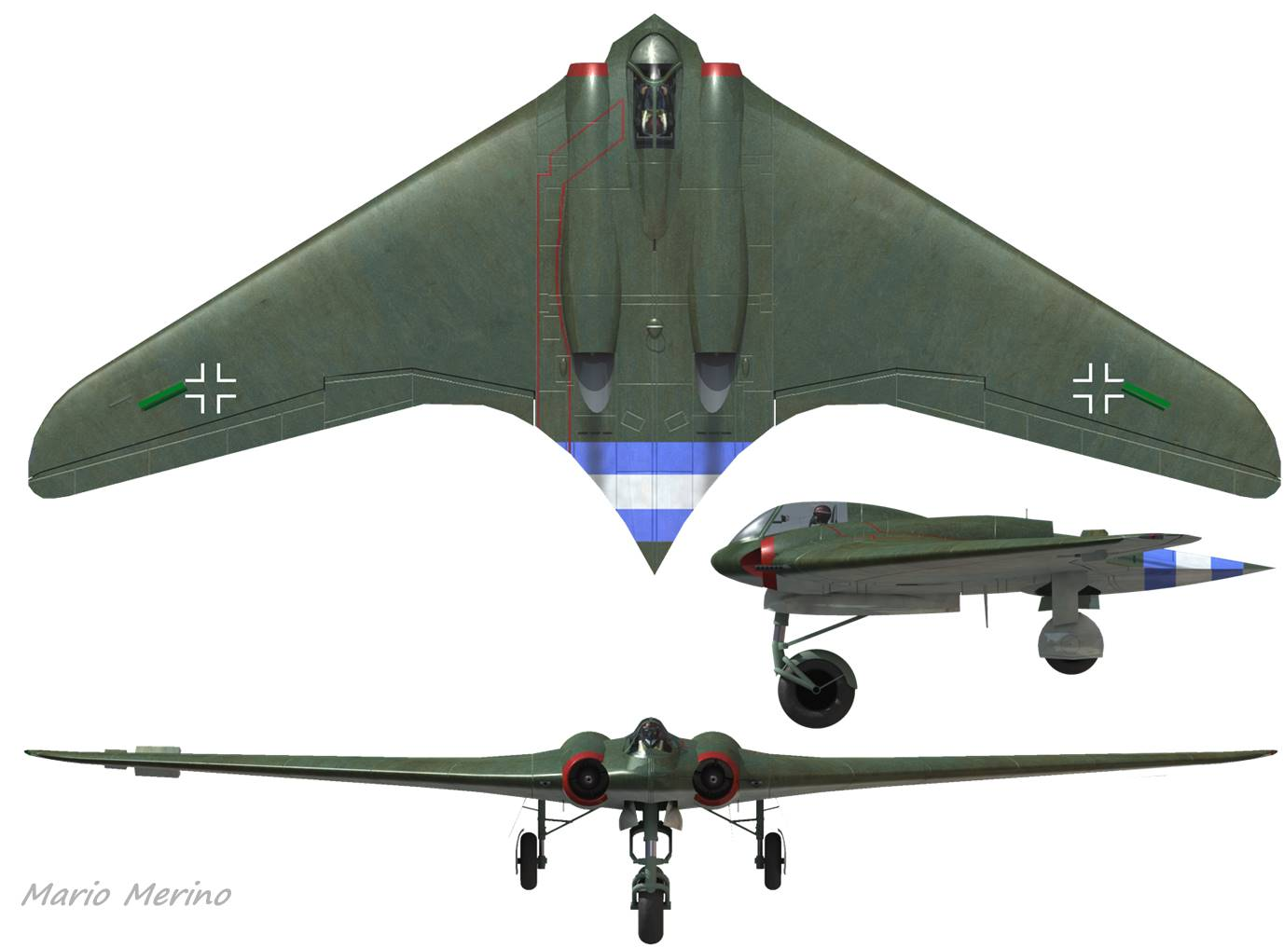
Horten Ho-229 (V.3)
Nose ballast
Jumo 004
1-eng. flameout
Lt. Irwin Ziller
Drag rudders
Drag rudder penalties defeat the advertised benefits of fin removal
Notes:
To stabilize the aircraft in yaw, the design incorporated drag rudders, in lieu of a swept vertical fin, which we suggest would have offered superior handling and safety with a net reduction of drag. Indeed, Walter Horten recommended to his brother Reimar that a central fin be added (19). The drag rudders, which opened both top and bottom, alternately left and right, could not offset the yaw moment of single-engine flameout. This shortcoming proved fatal for the first and only test pilot (Lt. Irwin Ziller) to encounter this condition.

Slide 30
Ho-229 Wing Sections, Properties, and Twist
Station Thickness c_{mac} zero-lift, ζ
Centerline: 17% +0.035 -0.5º
Shoulder: 14% 0 +0.9º
Outboard: 11% 0 0.0º
Center:Reflexed
Zero-lift Line
Shoulder: No Reflex
Twist per Arthur Bentley Drawing
“Chord-line” twist: 1.5º
“Zero-lift-line” twist: -0.5º
“Net flat-plate” twist: 1.0º
Outb’d ~ Symmetrical
Notes:
Contrary to widespread popular literature on the Ho-229, the aircraft was built with only 1.5º of chord-line twist, as indicated by the Arthur Bentley drawings. But with -0.5º zero-lift-line incidence at the wingroot, the equivalent flat-plate twist was then only 1.0º, far less than that necessary for the "bell-shaped load distribution" attributed to the design in the popular literature. As built and flown, the Ho-229 exhibited a "pseudo-elliptical" lift distribution as shown next.

Slide 31
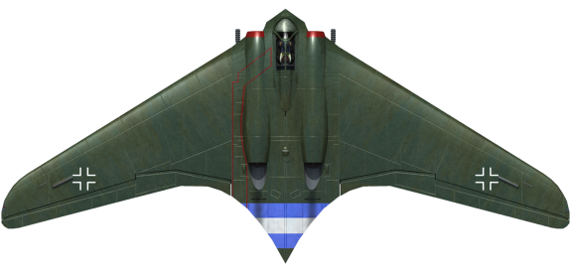
Transonic Effects ~ Drag Rise
Zero-lift profile drag, NACA-00xx
Göthert, NACA TM 1240, p. 20
18%
Ho 229 likely slowest of all the German Jets
12%
09%
06%
Curve fit, limited to ranges shown:
M1 = 1 - 0.27 * (tau / 0.10) ^ 0.7
M2 = 1 - 0.155 * (tau / 0.10) ^ 0.7
cd0 = 0.005 + tau / 60 ' sub-critical
{M>M1}: ' add post-critical: cd0 = cd0 _
+ (0.028 - cd0) * ((M - M1) / (M2 - M1)) _
^ (5.1 * (tau / 0.18) ^ 0.5)
3%
Notes:
The pronounced effect of thickness on the transonic drag rise of NACA symmetric airfoils at zero lift is shown above. At low Mach number, thickness has only a minor effect on drag but, for example, a 9% thick airfoil at Mach 0.85 has about twice the drag of a 6% thick airfoil. And for a 45-deg swept-infinite wing of 9% streamwise thickness at flight Mach 0.85, the normal drag coefficient (c_{dn}) is evaluated for an airfoil of 13% thickness at normal Mach 0.60. But the apparent benefit in drag is substantially less for a wing of finite span.
The Ho 229 jet, which we shall revisit later herein, exhibited an unswept centerbody region while incorporating a centerline airfoil with an upper-surface "apparent" thickness in transonic flow perhaps exceeding 18%. We then expect the Ho 229 to have been by far the slowest of the German jets, paper or real.

Slide 32

3D lifting-line application ~ Ho-229 ~ Cruise
“Pseudo-elliptical” lift
7% static margin
Center drag spike
"Clean" L/D ~13
1.5º washout (Arthur Bentley)
Pseudo-ellipse (not bell) load
Bell-lift-loading “fantasy”:
10º washout unloads tips
Yaw stability diminished
Twist increases pitch up
c.g. fwd to compensate
More ballast for fwd c.g.
Notes:
Shown here are sparwise distributions of aerodynamic loads on the Ho-229 at cruise. Notice the "pseudo-elliptical" lift loading on the wing, and the center drag spike. Assuming the drag rudders remain stowed, the aircraft exhibits a "clean" lift/drag ratio around 13 for an assumed static margin of 7%.

Slide 33

3D lifting-line Application ~ Ho-229 ~ Sideslip
Roll-due-to-yaw OK (c_{l} = “c_{LL}”< 0)
Marginal yaw stability (c_{Ncg} > 0)
- Typical of “isolated wing”
- Including simulated canopy
- Drag rudders likely active
Notes:
Now applying sideslip of 4º nose left, we find only small left-right differences in tip-local lift and drag. Accordingly, the aircraft is only marginally stable in yaw (drag rudders stowed). However, the roll-due-to-yaw has the correct sign for favorable handling qualities. But given the marginal yaw stability, we surmise that the drag rudders could not have remained stowed, so the design cannot be credited for the "clean" lift-drag ratio previously computed. Nor would the aircraft represent a fast and stable gun platform.

Slide 34

Ho-229 Modified for Bell-shaped Lift ~ Cruise
"Bell lift" needs 10º twist
Alpha: was 3º, now 8.4º
Incr. pitching moment
c.g. was 35%, now 22%
Nose ballast now required
L/D: was 13, now 9
Next: re-test yaw stability
Notes:
If the Ho-229 had instead incorporated bell-shaped lift, twist approaching 10º would be needed, as shown at lower left. Such would develop a strong pitchup moment, balanced by a forward c.g. shift via increased ballast. But, as shown by Albert Betz, “isolated wing” lateral stability requires non-zero "tip-local" lift, where yaw-stabilizing forces originate as left-right differences in induced drag. Since bell-shaped lift by definition “unloads” the wingtips (as seen at upper right), we predict after the fact that the Ho-229 with bell-shaped loading would have been neutral in yaw (see also the next slide). But with or without bell loading, the necessary regular deployment of drag rudders, likely with drag exceeding that of a fin, would have defeated the popularly-advertised “drag reduction with empennage removal.”

Slide 35

Ho-229 Mod for Bell-shaped Lift ~ Sideslip
Yaw: was marginal, now neutral
Ho-229 "bell-load" study
"Clean" L/D reduced
Nose ballast added
Yaw stability eliminated
Drag rudders more active
Notes:
Finally for the Ho-229, we study the effects of sideslip with twist for bell-shaped lift distribution. As expected, we find the aircraft to be neutral in yaw (c_{Ncg}=0).
Then to summarize our study of the effects of incorporating the mythical "bell-shaped loading" for the Ho-229, we discover (a) increased weight with added ballast to offset the added pitch-up moment, (b) reduced L/D with the departure from elliptical lift, and (c) neutral yaw stability with the removal of the tip-local lift necessary for "isolated-wing" yaw stability.

Slide 36
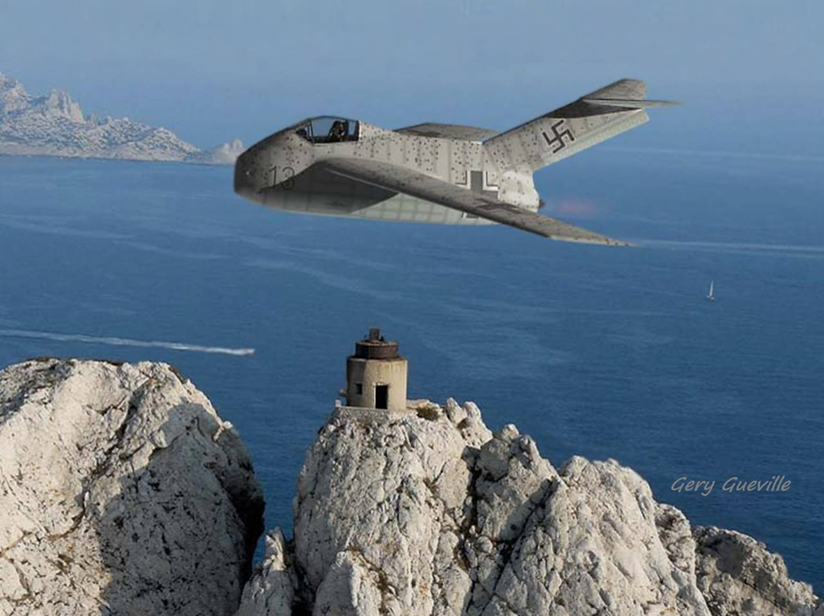
Focke-Wulf Ta183
Ta_ ~ Kurt Tank
Chief engineer
Test pilot
Notes:
The Focke-Wulf Ta183 flies over the Mediterranean sea in this
imaginative scene by computer-graphic artist Gery Gueville.
The FW Ta183, although radical for its day, is the closest we will come herein to a “conventional” configuration. Development of the aircraft was well underway when the war came to an end. Kurt Tank was the chief designer at Focke-Wulf, and he assigned his name with "Ta" to each aircraft model developed under his direction. Tank was also a pilot, and he test flew each design. Indeed, he flew some sort of aircraft every day, and upon landing would visit with many of the engineers at their drawing boards, often making a change or correction to each drawing (3).

Slide 37
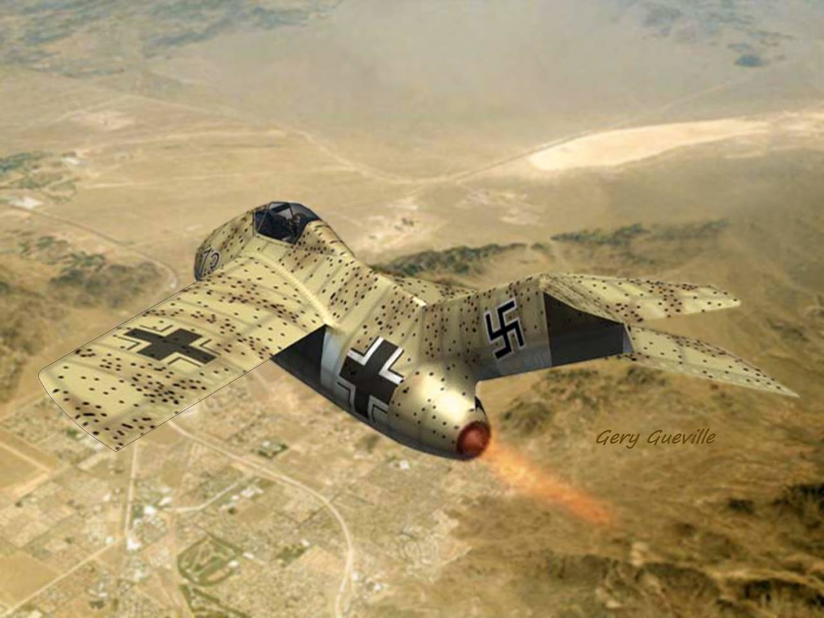
Notes:
The Ta183 is well camouflaged in this desert scene by artist Gery Gueville.

Slide 38
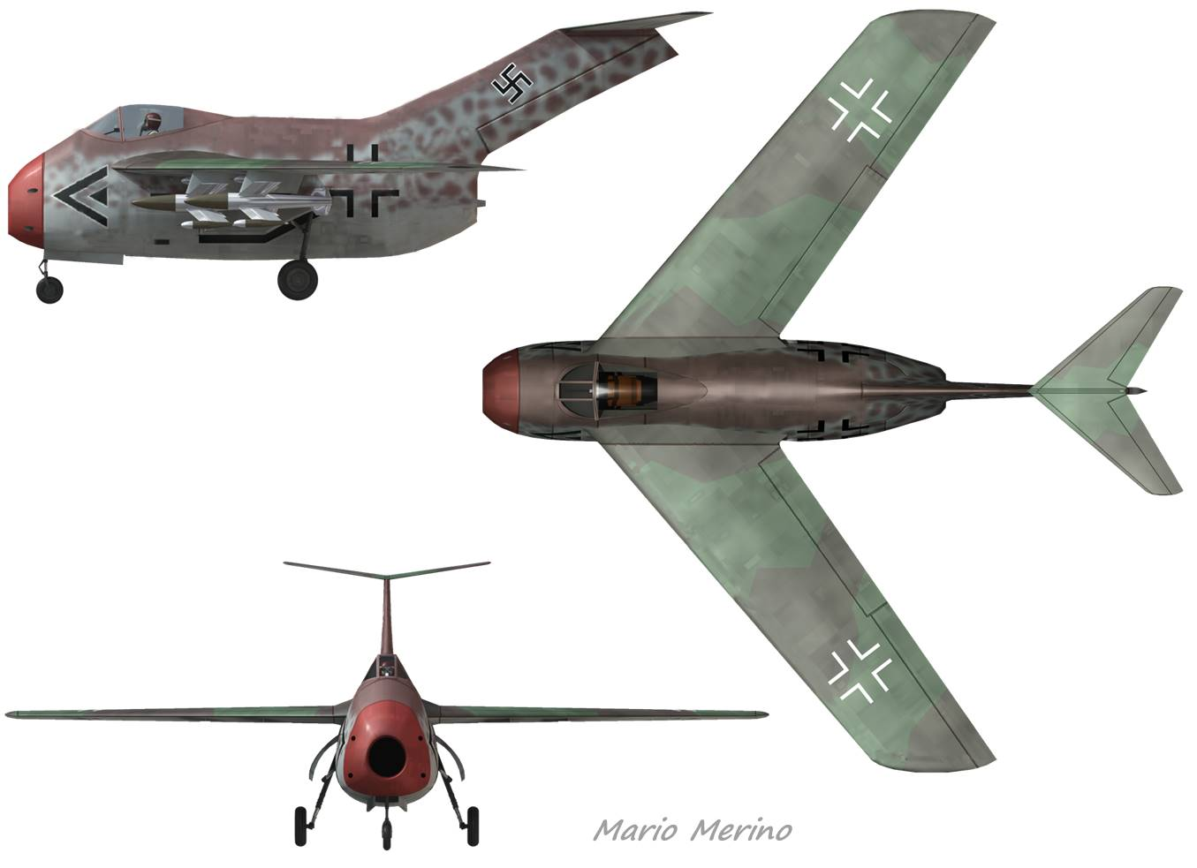
Focke-Wulf Ta183
Hans Multhopp
German Academy
Wind tunnel model
Detailed drawings
Notes:
The Ta183, noted by its highly-swept, constant-chord wing and highly-swept T-tail, was perhaps the closest the Germans came to implementing their high-speed aerodynamic research. It was also the "paper jet" which came closest to production, with all of its drawings complete just as the war came to an end (7).
The design was conceived by Hans Multhopp, at age 25 the youngest member of the German Academy of Aeronautical Sciences (3).
Hans Multhopp contributed significantly to the art of computing the loads on swept wings. Also, he authored the classic paper "Aerodynamics of the Fuselage," later translated as NACA TM 1036.

Slide 39

3D lifting-line application ~ Focke-Wulf Ta183 ~ Cruise
8% static margin
2º "equiv." decalage
L/D ~12
Notes:
The figures above comprehensively describe the aerodynamics of the Ta183, as computed by our model, at a representative “cruise” condition of 0.6 flight Mach number. Along the left and in the center, we show the aircraft with both the lifting and downwash lines on all significant aerodynamic surfaces. The afterbody is not included because it is immersed in downwash and low-quality flow, whereby its effects can be ignored. Notice the cruciform modeling of the forebody planform and profile as thin, low-aspect-ratio wings. At top center, we see the chord-weighted distribution of lift as a function of the non-dimensional position “p/h,” where “h” designates the halfspan and “p” the “y-z projected” distance along the spar. The central dip is caused by downwash imposed on the wing by the forebody which, per the theory of Robert T. Jones, has lift distributed elliptically. The wing is modeled with a zero-pitching-moment airfoil (with forward camber). It is interesting to see that the tail load is slightly positive. The aircraft has 8% static margin (the normalized c.g-to-a.c. distance). Along the right, we show the distributions of lift (normal force) coefficient, local upwash (negative), induced drag, and profile drag. The overall distribution of chord-weighted drag is shown at the bottom center. Although it may be difficult to distinguish the various curves, we note that the forebody planform drag is greater than the forebody profile drag because only the forebody planform is lifting. The trimmed lift-to-drag (L/D) is just over 12.

Slide 40
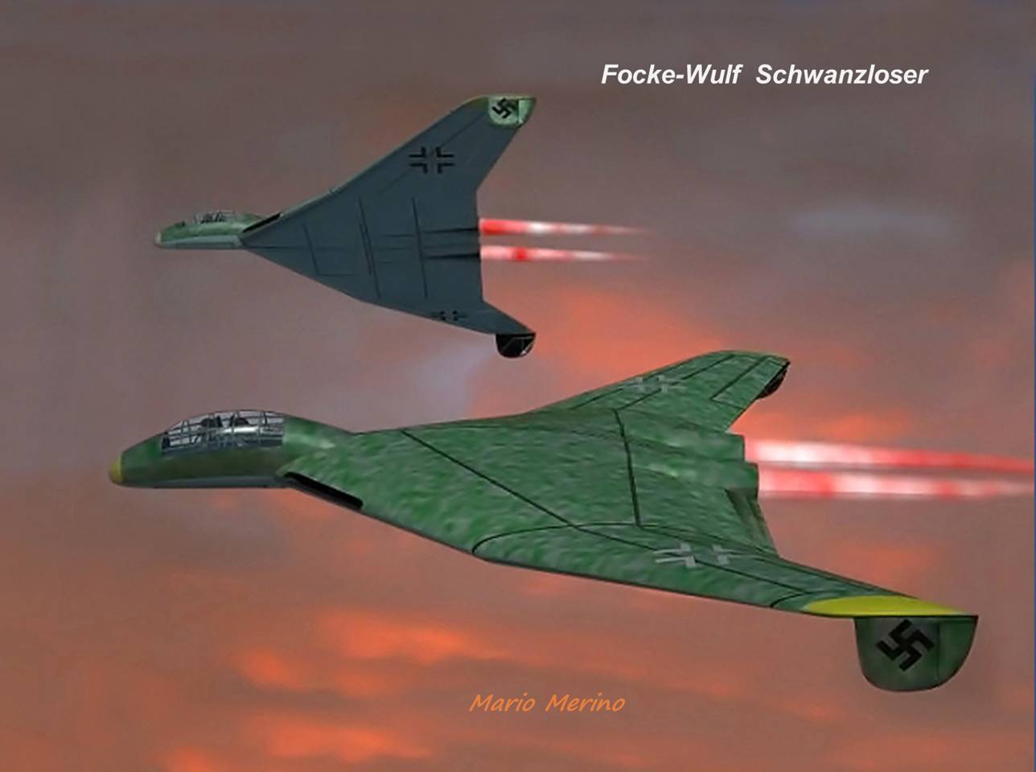
Notes:
Relative to the Heinkel “mostly-wing” configuration, the Focke-Wulf Schwanzloser concept may appear upon inspection to have perhaps better handling qualities, although the inverted winglets may need increased span.
Whereas a modern winglet, whether upright or inverted, would have a high aspect ratio to generate local aerodynamic thrust with local induced drag (negative) exceeding in magnitude the local parasitic drag, the winglets of the Schwanzloser were too broad for that role.
Readers familiar with the British Avro Vulcan, the design of which followed in time the Schwanzloser by only two years, will note strong similarities. However, the Germans and British independently arrived at these similar and practical configurations (17).
(17) A. Brookes, Vulcan Units of the Cold War, Osprey Publishing, 2009, p. 7

Slide 41
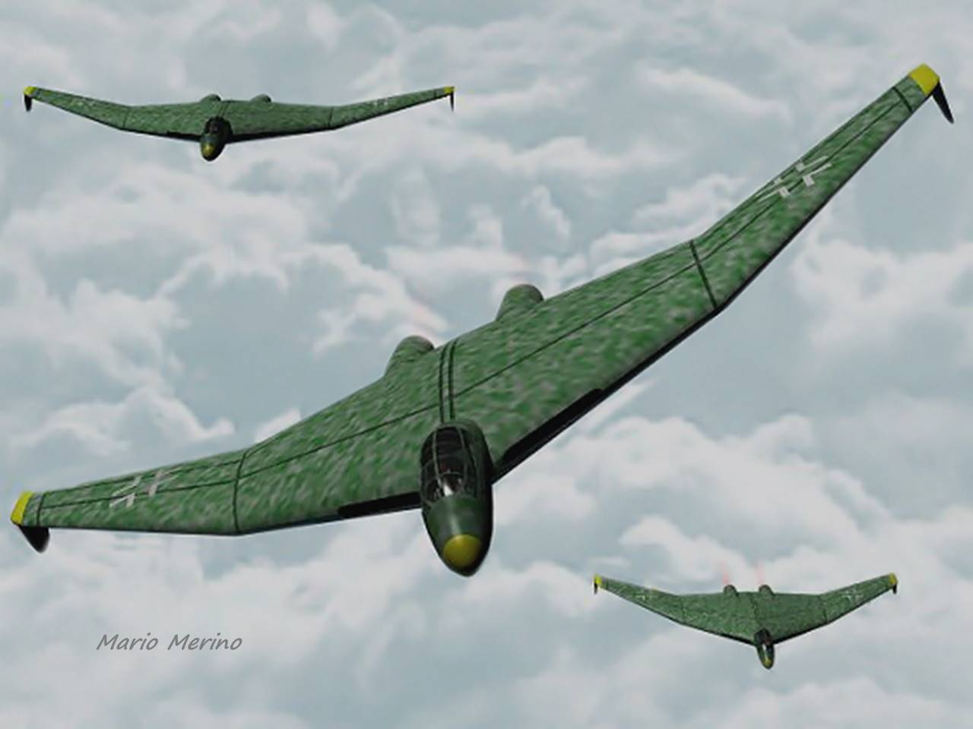
Notes:
In this computer-graphic image by Mario Merino, Focke-Wulf Schwanzloser jets return to base from a bombing mission.

Slide 42

3D lifting-line application ~ FW Schwanzloser ~ Cruise
Lift continues along winglets
Wing twist: 5º
Winglet toe-in: 0º
Notes:
The aerodynamic loads on the Focke-Wulf Schwanzloser at cruise are shown above. As with all tailless configurations studied herein, the aircraft is trimmed in pitch (c_{Mcg}=0) with the pitch-up moment developed by sweep and twist balancing the nose-down moment due to the c.g. forward of the a.c., in this case by 7% of the mean aero chord. The cruise angle of attack is 4º and the lift/drag ratio is about 15.
For this "first-pass" calculation, we have assumed that the winglet chord line is neither "toed in" nor "toed out" but the winglet is assumed cambered on the outboard surface, with an assumed 1º zero lift angle, to accommodate some portion of the outboard flow beneath the lower surfaces of the wingtips. No doubt for any aircraft with winglets, the winglet camber and toe-in/out should be optimized for the best compromise of performance and handling, biased toward the latter.

Slide 43

3D lifting-line application ~ FW Schwanzloser ~ Sideslip
Forebody & fins “compete”
“Just stable” in yaw
Favorable roll-due-to-yaw
Note L/R winglet incidence
Notes:
Now with 4º sideslip, we find that the Schwanzloser has only marginal yaw stability (0 < c_{Ncg} << 1), but generous roll-due-to-yaw (left roll via c_{LL}<0). Note the left-to-right difference in equivalent flat plate incidence at the lower left. Thus, as seen in the plots at both the upper and lower right, there is increased normal force, directed outboard, and increased drag on the left-hand winglet. Whereas the increased normal force therein tends to restore the nose to the right, the increased drag works together with the forebody sideforce to yaw the aircraft to the left. Thus the marginal yaw stability calls for greater winglet area, and/or perhaps winglet "toe-in" to reduce the drag increment in sideslip.
In the figure at the upper right, the distributions of normal force acting on the forebody in both pitch and yaw essentially overlay, both taking the form of a small "dome." Although these forces appear relatively small, they are both applied well forward of the center of gravity, thus affecting pitch and yaw moments. Their corresponding contributions to the distribution of drag are similarly overlayed in the plot at lower right.

Slide 44
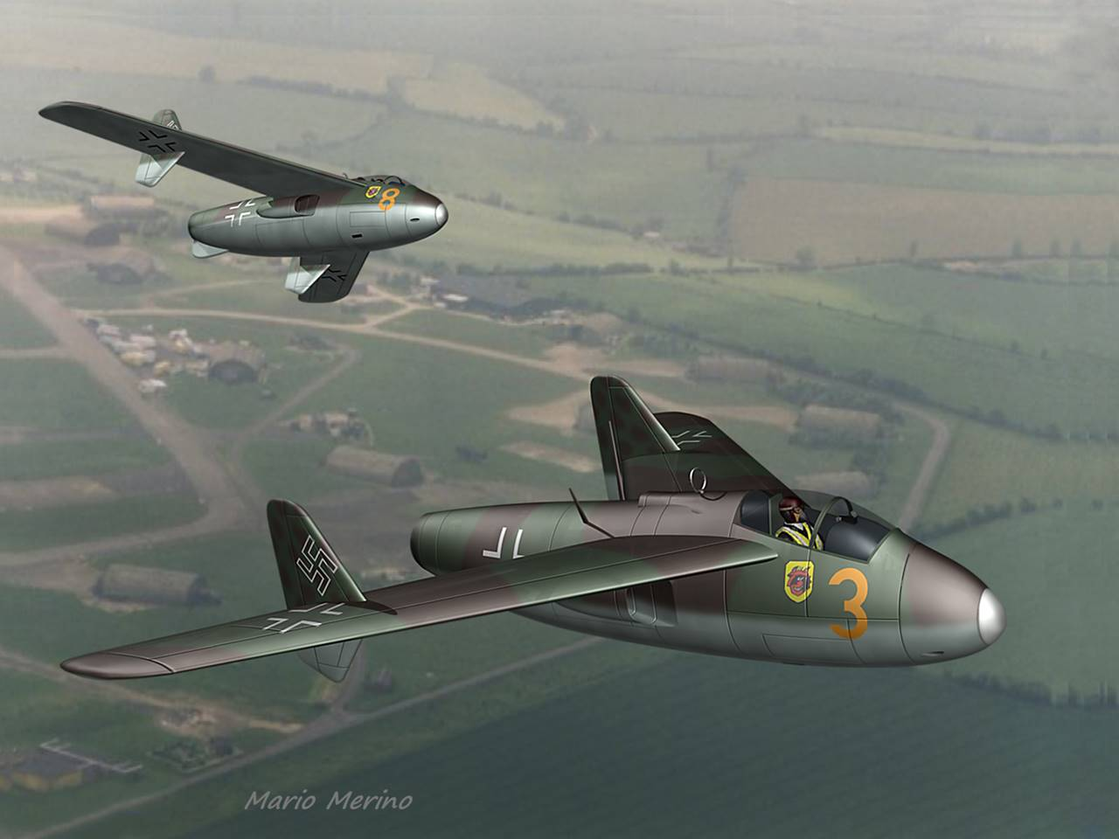
Junkers EF.128
Notes:
Here we're in formation with two Junkers EF.128 jet fighters in this action image by artist Mario Merino.

Slide 45
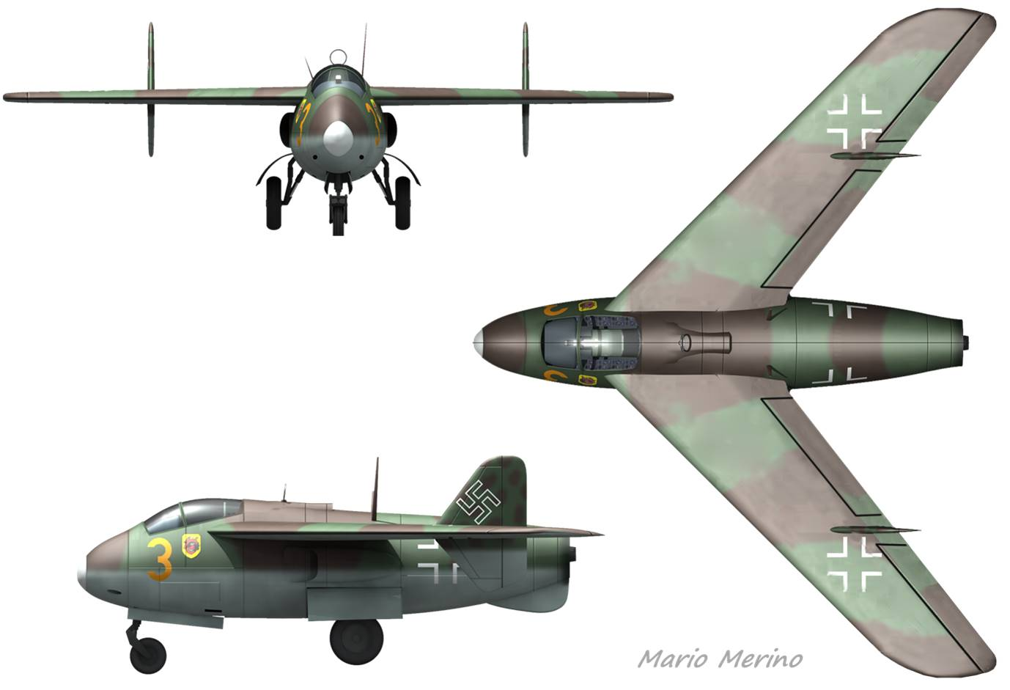
Junkers EF.128
Volksjäger contender
Wind-tunnel model, mockup
Inlet b'layer bleed top outlet
HeS 011 engine
Notes:
This precision three-view of the Junkers EF.128 German jet is
provided courtesy of computer-graphic artist Mario Merino.
The Junkers EF.128 was characterized by its highly-swept wing, a prominent pair of “finlets,” and ventral fin, altogether likely ensuring a stable gun platform. Little is known about its origin, except that the conceptual design and wind-tunnel test are attributed to Dr. Hertel, Mr. Gropler, and Dr. Backhaus (18). The design may have been first to incorporate inlet boundary layer bleed, with the bleed flow driven by the combination of increased pressure just upstream of the inlets and decreased pressure at the aft-facing outlet aft of the canopy. At low speeds, say below flight Mach 0.4, the bleed circuit would have flowed in reverse to the single HeS 011 engine. A mockup of the EF.128 was under construction, but the concept did not reach the prototype stage. And, the HeS 011 engine did not reach fruition.
(18) W. Schick & I. Meyer, Luftwaffe Secret Projects, Midland, 1997, p. 155

Slide 46

Junkers EF 128 ~ Cruise
Finlets stream aligned
Inflow: Finlet side loads
Induced drag penalty
Finlet
Forebody
4º parabolic twist
Finlet “fence” effect
Finlet upper: inb’d lift
Finlet lower: outb’d lift
Notes:
Above we show the aerodynamic loads on the Junkers EF.128 at cruise. One interesting feature is the inboard-directed lift of the finlets (which are assumed neither "toed-in" nor "toed-out"). These forces arise from the inboard component of flow above the wing, yielding step changes in the distribution of lift over the wing. But in accordance with the principle of conservation of vorticity, the vorticity and lift suddenly shed from the wing appears as vorticity and inboard-directed lift suddenly applied at the finlets.

Slide 47

Junkers EF 128 with Finlet Toe-out ~ Cruise
Finlets “toed” in/out
L/D improved 3%
Forebody
Finlet
2º upper toe-out
2º lower toe-in
Finlets ~ unloaded
L/D = 14.6 (+3%)
Notes:
Now, with the EF.128 finlets "toed out" on top and "toed in" on the bottom, their side forces, and contributions to induced drag, are largely eliminated. At upper right, the distribution of lift is now essentially continuous. The lift-drag ratio is now improved by about 3%. However, pitch trim requires a 0.5º increase in the parabolic washout of the wings. This suggests that a swept-wing aircraft can be controlled in pitch with symmetric "variable-toe" finlets (or winglets), and perhaps as well in roll with differential finlet (or winglet) variable toe. But further investigation would be needed to assess the flying qualities in sideslip.

Slide 48
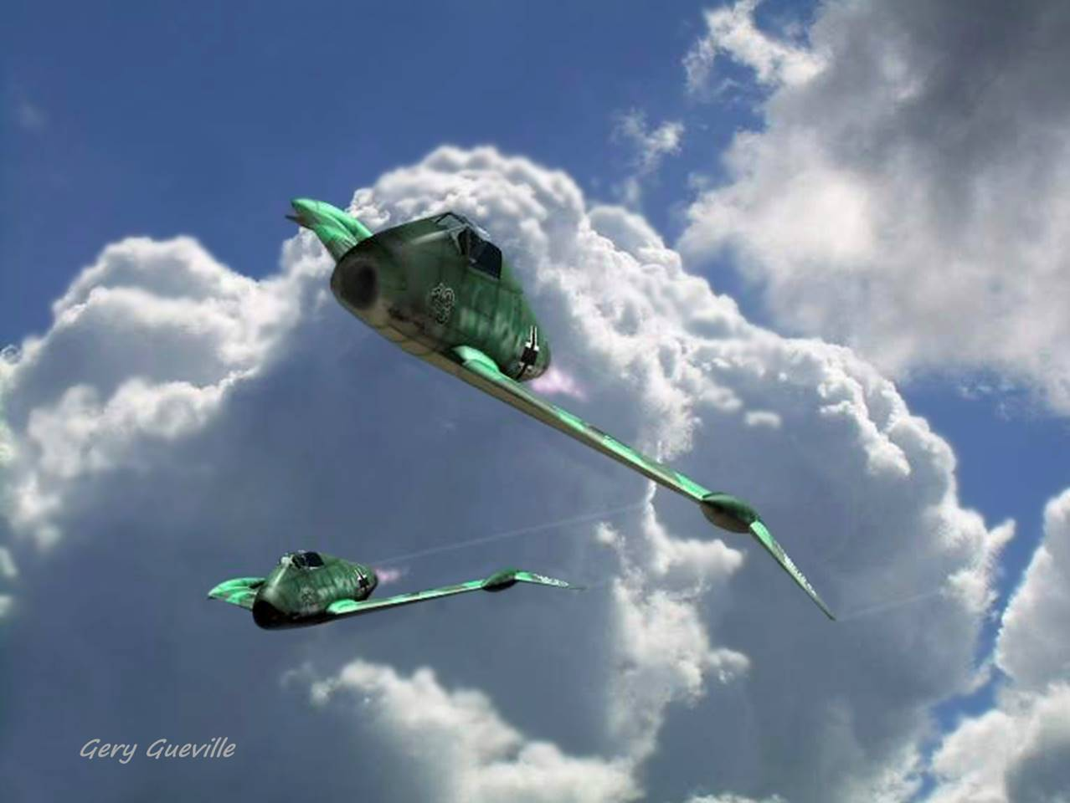
Blohm & Voss P.209
Dr. Richard Vogt
Dr. Dornier advice
Flying boats
Asymmetry
WW1 trenches
Notes:
Our next German jet is the Blohm&Voss P.209, shown
here in this striking image by CG artist Gery Gueville.
The chief designer at B&V was Dr. Richard Vogt. Early in Dr. Vogt's career, Dr. Claude Dornier advised him to acquire a distinctive design style. This he most certainly did, first with flying boats, then with asymmetric configurations, and toward the end of the war with several designs taking the general form of the P.209 shown here.
Dr. Vogt's unique designs were consistent with his lifelong disdain for established rules and authority. As a young pilot in WW1, he disobeyed and insulted his officers, and was sent to the trenches (3), barely surviving the war.

Slide 49
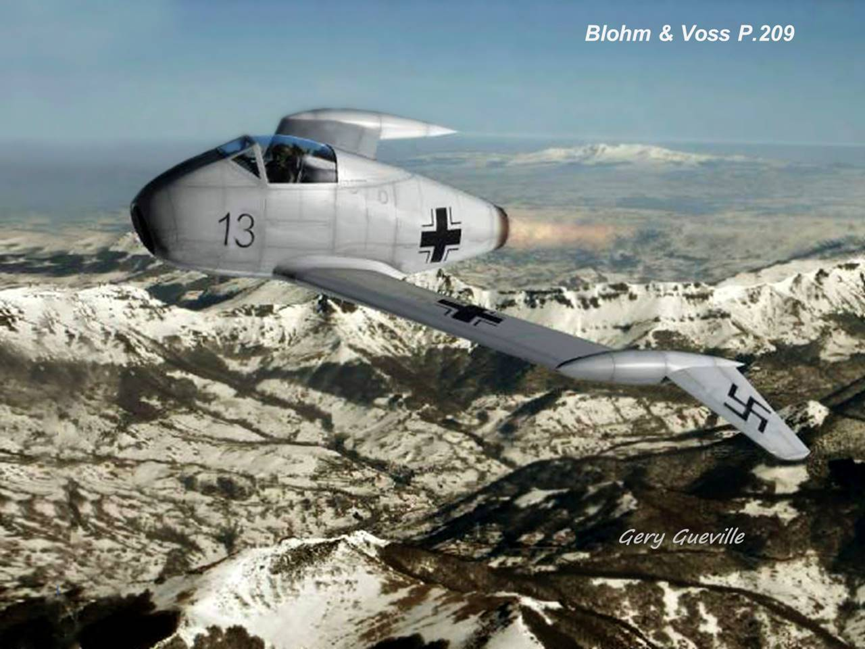
Notes:
Characteristic of the later designs by Dr. Richard Vogt of B&V were the outboard stabilizers or “taillets” of the P.209. With neither 3D-aero analysis tools available only after the war, nor wind-tunnel data for the P.209, Dr. Vogt would have been unaware that the “gull-wing” dihedral as originally drawn for the P.209 was insufficient to overcome the yaw-destabilizing effect of the forebody. Indeed, Dr. Vogt was persuaded to include fins in the follow-on design, the P.212 shown near the beginning of our presentation. For the P.209, we'll take the liberty of increasing the dihedral for our study of its aerodynamics. Accordingly, we'll designate that configuration as "P.209A."

Slide 50

3D lifting-line application ~ BV P.209A ~ Cruise
Upwash at lifting taillets
in spite of req’d decalage
2.5º "equiv." decalage
Positive tail incidence
Upwash & lift at tail
Notes:
Most fascinating for the P.209/P.209A is the upwash and positive lift on the taillets, in spite of their 2.5º net decalage (tails trailing-edge-up) needed for the nose-up trim pitching moment. In many respects, the taillets act as highly-canted winglets, having locally negative induced drag (only the total local chord-weighted drag is shown above). However, whereas a well-designed winglet would locally provide aerodynamic thrust,* the P.209 taillet profile drag more than offsets the local reduction of induced drag, so the sparwise distribution of drag (lower right) remains positive throughout. Next up: How does the aircraft handle in sideslip?
* An attendee at an SAE engineering presentation sarcastically joked
that he intended to propel his aircraft entirely with winglet thrust.

Slide 51

3D lifting-line application ~ BV P.209A ~ Sideslip
To provide yaw stability dihedral was increased beyond that of drawing;
Alternative: add fins
Stable in yaw (c_{Ncg} > 0)
Roll-due-to-yaw ok (c_{l} < 0)
Orig. dihedral inadequate
Notes:
The P.209A with 4º sideslip (nose-left) sees pronounced L-R differences in incidence, as shown at lower left. Based on the corresponding distribution of normal forces (upper right) we might expect the aircraft to roll right, but the outboard dihedral reduces the effective "moment arm" of the normal lift forces, whereby the calculations more correctly indicate a roll to the left (c_{LL}<0), the desired response. The yaw moment about the c.g. (c_{Ncg}) also has the desired sign. Thus, in contrast with the He P.1078C which has similar gullwing dihedral, the P.209A is predicted after the fact to have favorable handling qualities. Again, for this particular study the dihedral has been increased beyond that of the original drawings.

Slide 52
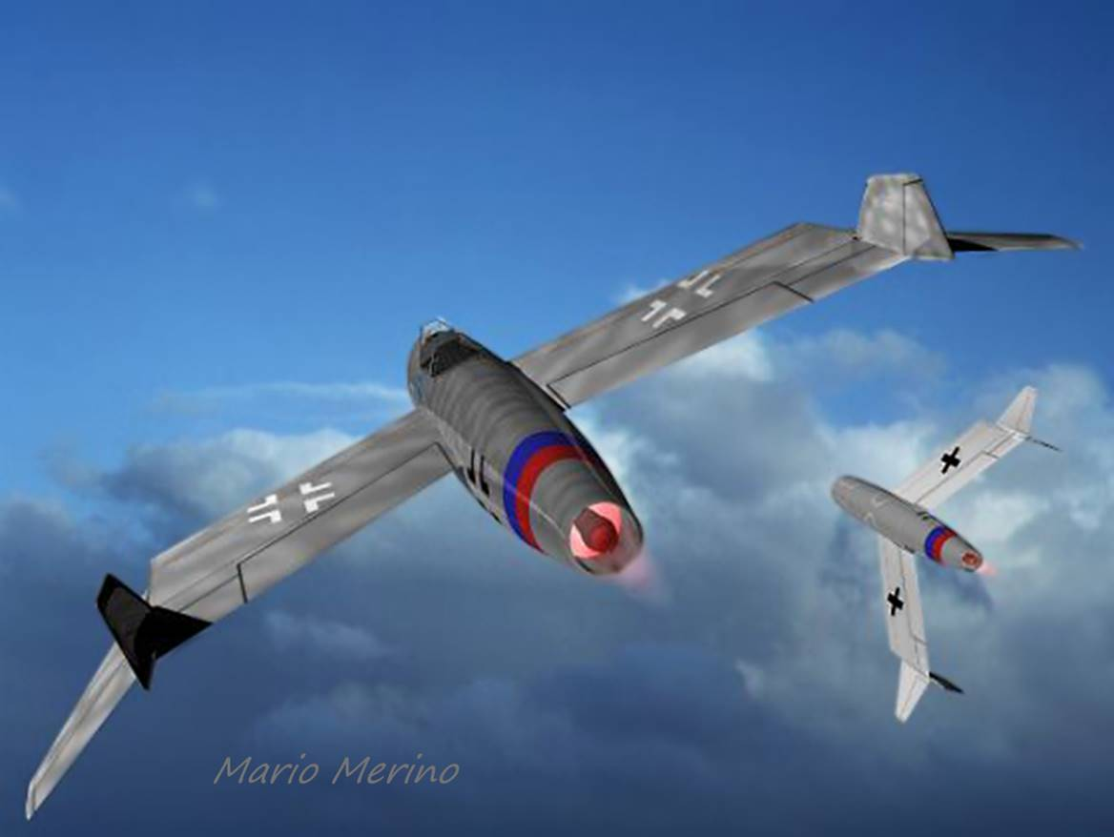
Blohm & Voss P.212
Notes:
In this action image by CG artist Mario Merino, Blohm & Voss P.212 jets maneuver in the clouds.

Slide 53
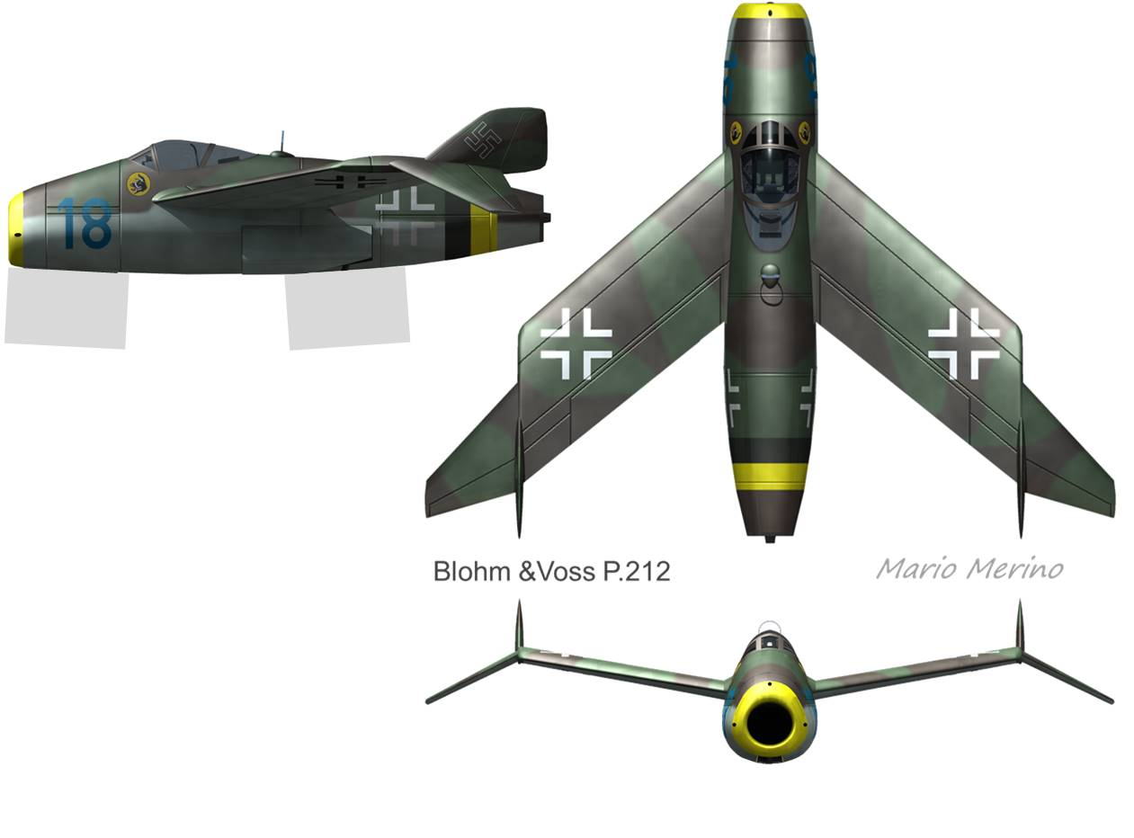
Blohm & Voss P.212
Notes:
The German jets were most visibly characterized by their radical configurations, such as the Blohm&Voss P.212 illustrated here by computer-graphic artist Mario Merino. But with the advent of the axial turbojet engine came the lengthening of the forebody, sweep of the wings, and penetration of the "transonic treachery" flight regime. All these were the hallmarks of the German Jets, and we'll study each topic in some detail.

Slide 54
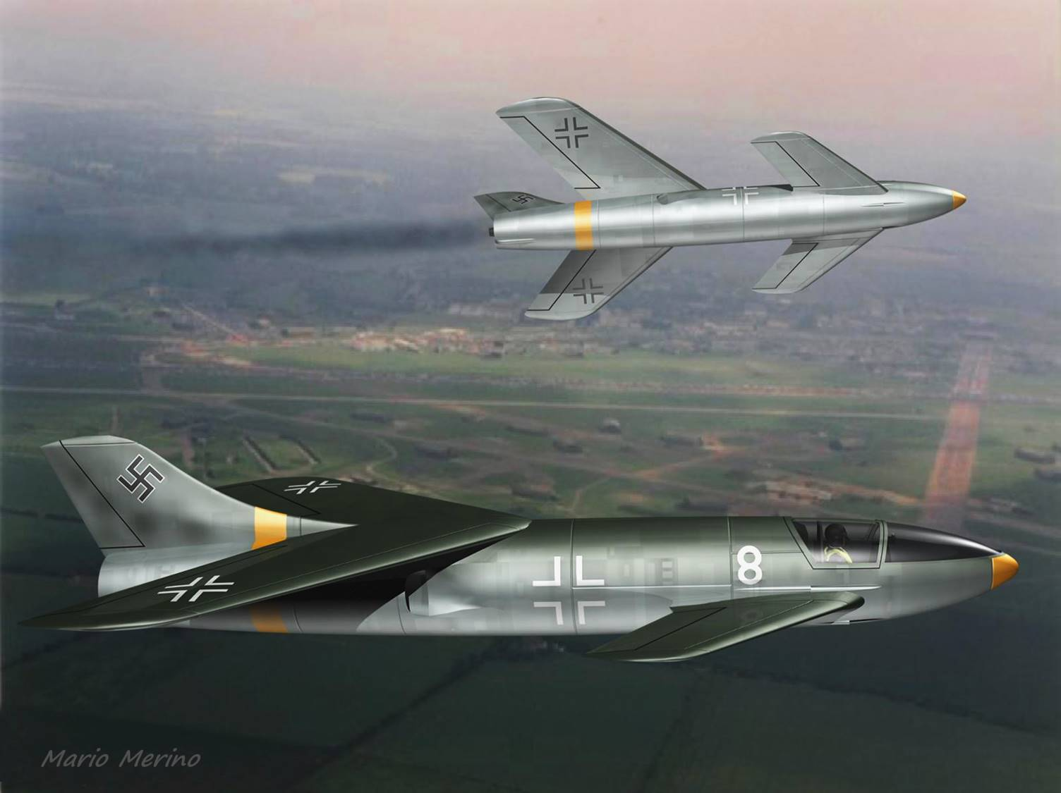
Messerschmitt Ente
Notes:
Messerschmitt Ente jets maneuver in this late-evening scene by Mario Merino.

Slide 55
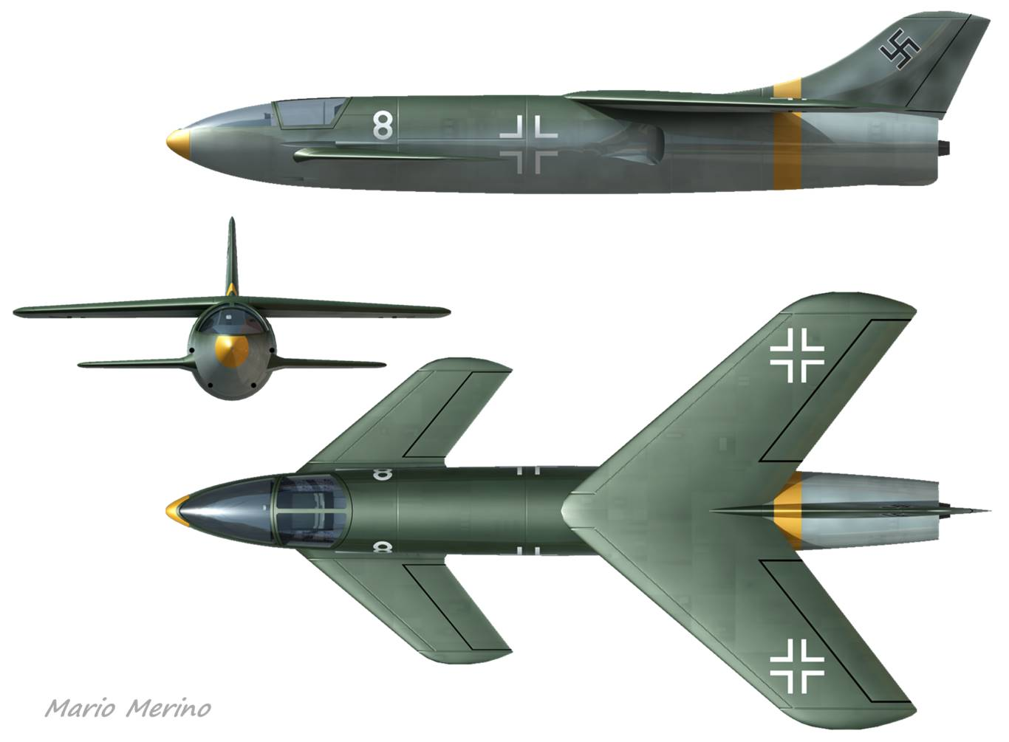
Messerschmitt Ente
c.g. position
yaw stability
canard wake
L/D
Notes:
Our next-to-last German jet, the Ente, is certainly among the most interesting. Its many design challenges would have included (1) locating an appropriate position for the c.g., (2) calculating the lift distributions for the wing and canard, (3) validating yaw stability, and (4) mitigating the effects of canard wake ingestion at the engine inlets. With the computational methods and hardware unavailable to the Messerschmitt engineers at the time, we can today readily meet most of these challenges.

Slide 56

3D lifting-line Application ~ Me P.1110 Ente ~ Cruise
Note lift distributions of
Forebody, canard, wing
1º “flat-plate” decalage
F’body d’wash canard
Canard d’wash wing
“Classic canard” loads
c.g.
a.c.
Notes:
This chart shows the aerodynamic loads on the Messerschmitt Ente at cruise. The aircraft is trimmed in pitch with just 1º "flat-plate decalage" (the canard-to-wing incidence difference). Selecting 12% static margin, the c.g. resides well forward of the mean-aero-chord leading edge.
At right we show the sparwise distributions of lift and drag. The small “dome” at upper right represents the distribution of forebody lift. The forebody wake induces a depression in lift at the canard, and the canard wake induces a depression of lift at the wing. The relatively low L/D is to be expected from the low aspect ratios of both main lifting elements.

Slide 57

3D lifting-line Application ~ Me P.1110 Ente ~ Sideslip
Robust yaw stability and roll-due-to-yaw
Reader exercise:
Find lift & drag curves for wing, canard, fin, forebody planform, and forebody profile
Notes:
With the Me Ente now in 4º sideslip we discover, perhaps to our surprise, robust yaw stability and robust roll-due-to-yaw. At both upper right and lower right, the various curves representing the distributions of lift and drag take on highly irregular shapes. In each case, the three inner-most curves represent the forebody planform, forebody profile, and vertical fin.

Slide 58
Presentation Contents
Historical background
Why a jet is faster than a prop
Aerodynamics
  - The swept-wing breakthrough
  - Forebody: a low-aspect-ratio wing
  - 3D semi-empirical lifting line model
  - Transonic treachery
  - Case study: Me 163B
Operational “turbos”
  Messerschmitt Me 262
  Heinkel He 162
Experimental jet: Horten Ho 229
Paper jets: Focke-Wulf, Junkers, Blohm&Voss
Summary, conslusions, and suggestions

Slide 59
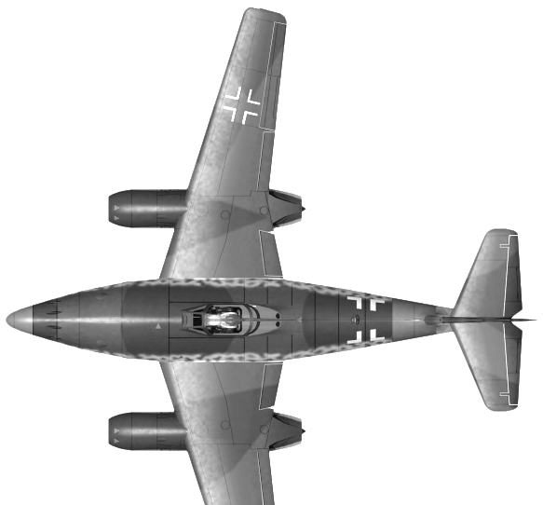
Summary, conclusions, and suggestions
Me 262: 20% faster than the fastest Allied aircraft
Tech. years ahead, but with numbers too small
Numerous low-tech aircraft defeat high-tech few
Norm Augustine: “fighter price 2x every 4-years”
Göering: support wrong weapon; delay right weapon
Horten: Drag-rudder penalty > fin-removal benefit
2-engine design: ensure safe with one-engine-out
Transonic Mach: sweep wing & avoid thick airfoil
Still learning from the German Jets, 70-years after

Slide 60
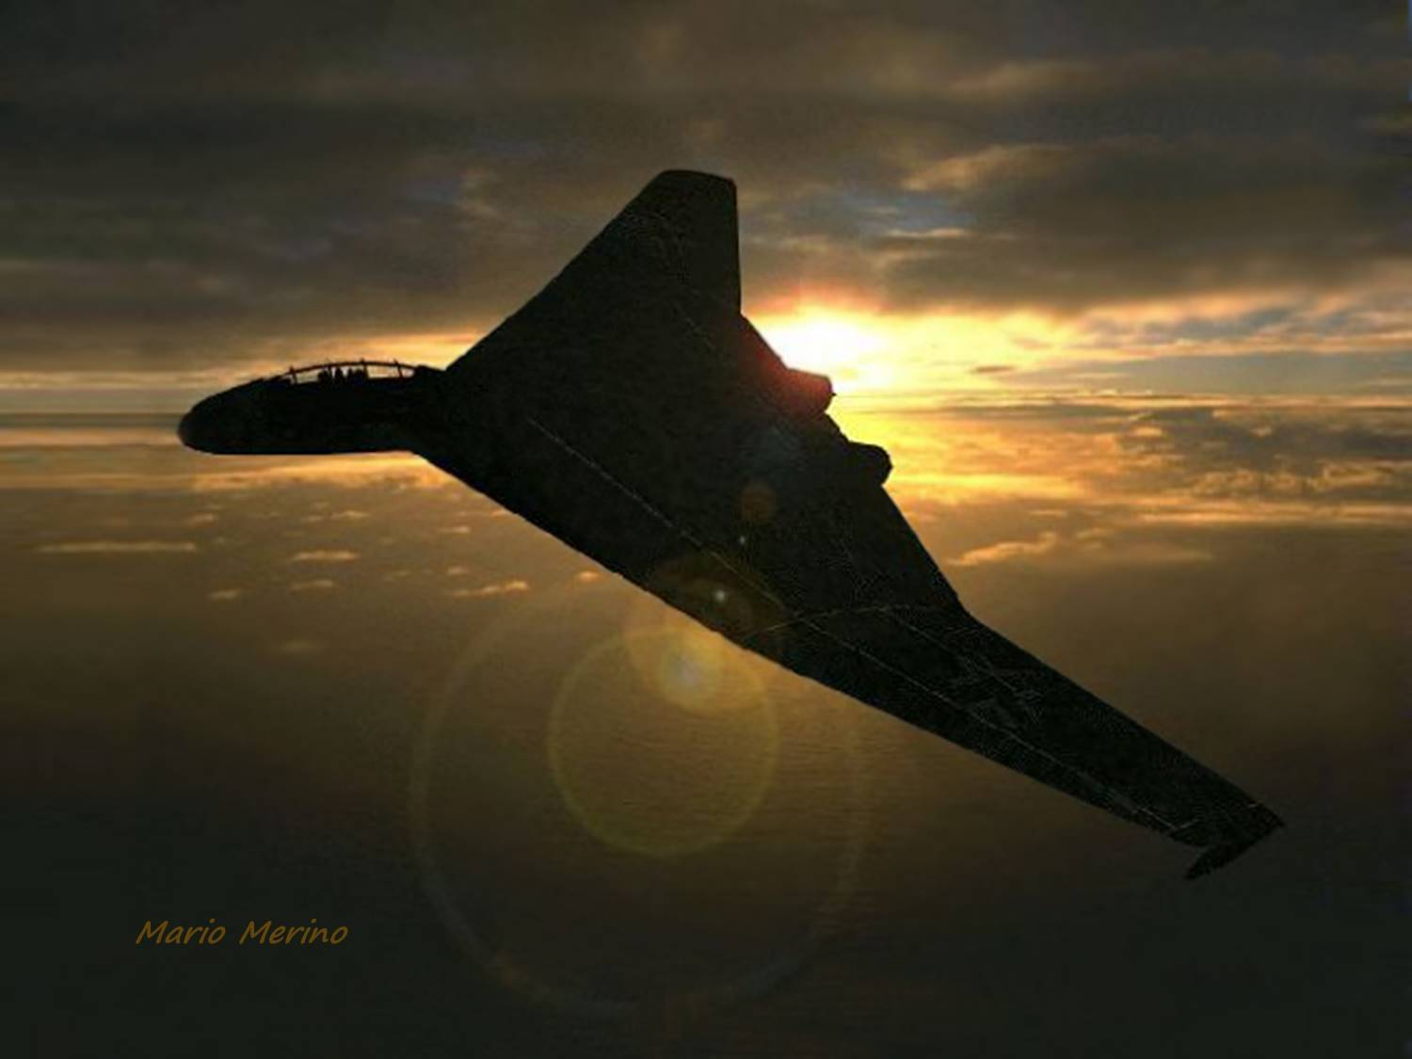

Slide 61

About the Author
Phil Barnes has a Bachelor’s Degree in Mechanical Engineering from the University of Arizona and a Master’s Degree in Aerospace Engineering from Cal Poly Pomona. He is an expert in the performance analysis of aircraft vehicles and subsystems at Northrop Grumman. Phil has authored numerous technical papers and presentations on airfoils, wings, propellers, gears, and orbital mechanics. In addition, he is author of landmark studies on dynamic soaring and regenerative-electric-powered flight. This presentation integrates Phil’s technical skills with his passions for aerodynamics and unique configurations.

